Slide 1
June 15, 2023 –WREIC Conference
Addressing the Early Intervention Needs
of Children Who are Deaf/HH in a Rural
State With Limited Resources
Notes:
Nancy
We are so excited to be here today to share with you how leaders and members of Wyoming Families for Hands & Voices are behind the wheel helping to steer the journey towards developing the “I” in the Wyoming EHDI Program. We would love to tell you about our “road trip” and how utilizing a facilitator helped to provide objectivity and guidance in keeping the “pit crew” on the right track.
We believe the road we traveled to improve the early intervention (EI) experience for children in the state of Wyoming may lend “travel tips” usable to others on a similar journey in your states/territory/province etc..
Our goals for today will be to share how Wyoming Stakeholders identified, agreed, and implemented a process to improve early intervention for children who are deaf/Hard of Hearing (D/HH), ultimately creating a Systems Change within our state and for you to hopefully be able to take home and use some of our strategies to your own state/territory etc.

Slide 2
What’s Up With All the Post-It Notes?
Preview of Group Activity
What is your state doing to meet the challenges of serving D/HH children and their families in early intervention? Put a star next to the one thing you feel is making the biggest impact.
What types of providers serve your children who are D/HH and their families in early intervention. What are their required qualifications? How is your state supporting these providers? (ex: specific trainings? Initial and ongoing training?)
Notes:
Betsy

Slide 3
What’s Up With All the Post-It Notes?
Preview of Group Activity (cont.)
What are your go-to resources in working with children who are Deaf/HH and their families in early intervention?
What is your state doing to encourage parent engagement in activities, parent support groups, state events and other connection opportunities?
Notes:
Betsy

Slide 4
TODAY’S OUTCOMES
Share how stakeholders in Wyoming identified and agreed upon a process to improve early intervention for children who are deaf/hard of hearing (D/HH).
Participants will respond to questions as a way for ALL OF US to work towards improving EI services.
Notes:
Nancy
We are so excited to be here today to share with you how leaders and members of Wyoming Families for Hands & Voices are behind the wheel helping to steer the journey towards developing the “I” in the Wyoming EHDI Program. We would love to tell you about our “road trip” and how utilizing a facilitator helped to provide objectivity and guidance in keeping the “pit crew” on the right track.
We believe the road we traveled to improve the early intervention (EI) experience for children in the state of Wyoming may lend “travel tips” usable to others on a similar journey in your states/territory/province etc..
Our goals for today will be to share how Wyoming Stakeholders identified, agreed, and implemented a process to improve early intervention for children who are deaf/Hard of Hearing (D/HH), ultimately creating a Systems Change within our state and for you to hopefully be able to take home and use some of our strategies to your own state/territory etc.

Slide 5
WY Families for Hands & Voices
WY Early Hearing Detection and Intervention (EHDI) Program
WY Department of Health - Early Intervention and Education Program (EIEP)
University of WY - Communication Disorders
Getting the right pit crew
WY Department of Education - Outreach Services for the D/HH
Child Development Services of WY
Marion Downs Center
Notes:
Nancy
Key step - getting the right people on the bus (e.g., taking the time to bring key stakeholders/agencies on board).
Our former EHDI coordinator was instrumental in understanding the importance of creating and building a cohesive team of state stakeholders: individuals who were dedicated to the improvement of ensuring that children who are deaf/hard of hearing in Wyoming had access to quality early intervention.
This team consists of individuals from: the Wyoming EHDI Program, University of Wyoming, Child Development Services of Wyoming, Marion Downs, Outreach, Department of Health - Early Intervention and Education Program, and Hands & Voices.

Slide 6
“Pit Crew” - WEII Core Team Members
Notes:
Nancy
We are so excited to be here today to share with you how leaders and members of Wyoming Families for Hands & Voices are behind the wheel helping to steer the journey towards developing the “I” in the Wyoming EHDI Program. We would love to tell you about our “road trip” and how utilizing a facilitator helped to provide objectivity and guidance in keeping the “pit crew” on the right track.
We believe the road we traveled to improve the early intervention (EI) experience for children in the state of Wyoming may lend “travel tips” usable to others on a similar journey in your states/territory/province etc..
Our goals for today will be to share how Wyoming Stakeholders identified, agreed, and implemented a process to improve early intervention for children who are deaf/Hard of Hearing (D/HH), ultimately creating a Systems Change within our state and for you to hopefully be able to take home and use some of our strategies to your own state/territory etc.

Slide 7
WEII Core Team “Pit Crew”
Christie Fritz: Wyoming Department of Education, Education Outreach
Consultant, Teacher of the Deaf
Sarah Fitzgerald: Wyoming Early Hearing Detection and Intervention (EHDI) Program, Co-Coordinator
Wendy Hewitt: Wyoming Families for Hands & Voices, Executive Director
Kim Reimann: Wyoming Families for Hands & Voices, Guide By Your Side - Program Coordinator; CDC+ Audiology - Parent Advocate/Family Educator
Notes:
Nancy: Introduce each person present

Slide 8
WEII Core Team“Pit Crew”
Annette Landes, SLP-CCC-A, WEII Plus Coordinator, WY Families for Hands & Voices
Betsy Tengesdal, Parent, Teacher of the Deaf/HH, Behavior Consultant
Nancy Pajak M.S, CCC-A , Educational Audiologist Consultant/Liaison
Marion Downs Center
Notes:
Introduce each person present

Slide 9
WEII Core Team“Pit Crew”
Judy Juengel, M.S.,Wyoming Department of Health, Early Intervention and Education Program (EIEP), Part C Coordinator
Dr. Kalley Ellis, Au.D. Pediatric Audiologist CDC + Audiology, Wyoming EHDI Program Audiologist
Cheryl Johnson, Ed.D.: Marion Downs Center, Consultant
Sandra Abbott Gabbard, Ph.D. President/CEO Marion Downs Center
Notes:
Nancy Introduce each person present

Slide 10
Additional WEII Larger Group Members
Kim Caylor, Early Intervention and Education Program (EIEP) Unit Manager, WY Department of Health, Behavioral Health Division (WDH - BHD)
Teresa Garcia, M.S., CCC-A, University of WY Clinical Professor/ Audiology Clinical Director
Jaime Stine, Director of Regions 8 and 11, Child Development Services of WY Representative
Jennifer Petri, 619 Coordinator, WY Department of Health Behavioral Health Division (WDH - BHD)
Jolene Flores, Contracts and Data Specialist, WY Department of Health Behavioral Health Division (WDH - BHD)
Notes:
Nancy People whose hearts are in the work -

Slide 11
Factors contributing TO GETTING STARTED
Colorado
Wyoming
CO School for the Deaf and the Blind (CSDB)
CO Home Intervention Program (CHIP)
Outcomes and Developmental Data Assistance Center for EHDI Programs (ODDACE)
DEVELOPING THE “I” IN EHDI.
Awareness of and responsibility for the need for best practice EI service delivery model.
Federal Funding (HRSA)
Marion Downs Center
Gift from WY resident.
Guidance and mentoring.
Developing the “I” in EHDI.
01
02
03
04
Notes:
Nancy: Four factors came together at the same time to support our efforts in improving EI in Wyoming including HRSA funding for the WY EHDI, a gift to the Marion Downs Center to support the WY EHDI Program, collaboration with our neighbor to the south, Colorado, as well as the WY EHDI program continuing to focus on the “I” in EHDI through various approaches to allow for the provision to high quality EI for children who are D/HH.

Slide 12
Wyoming Early Intervention Initiative (WEII)
for Families and Their Children
Who Are Deaf or Hard of Hearing
Notes:
Nancy
The culmination of our hard work and efforts formed the WEII: The Wyoming Early Intervention Initiative. With the motto of Together WEII Can Do It! Because it truly takes a good group of people to make a difference, starting with the parents.

Slide 13
WEII Drives to Develop the “I” in EHDI
The reason to screen is to intervene.
We Recognized WHY Early Intervention is important:
Brain development
Language development
Minimizing developmental delays
Long term success
Notes:
Nancy:
Newborn hearing screening, identification of children who are D/HH, and referral to EI are important components of WY EHDI. However, Wyoming recognizes that the quality and quantity of EI affects developmental progress and outcomes.

Slide 14
WEII Recognized WHY Early Intervention is Unique for children who are Deaf/hard of hearing (D/HH):
Small window for neurological development
Direct access to language needed
Lack of incidental language
Language (spoken/sign) is the foundation for development
Notes:
Nancy: important to be able to express why EI is unique for DHH children within the Part C system

Slide 15
Considerations for Wyoming
D/HH Specific
Very few specialized EI providers. No in state Deaf/HH Teacher Training Programs
Rural and Frontier
50th in population
10th in physical size
No School for the Deaf
Part C (birth to 3) and Part B (3 to 5)
14 CDC Regions with 40+ sites under Dept. of Health
Qualifying for Part C
Any type, degree of hearing loss.
Change can be scary
Notes:
Nancy: Positive and Negative Combination
Just out of the “starting gate,” it was important to recognize the several different attributes about Wyoming:
Here’s are some key components about Wyoming:
We are a very large state physically, 10th largest state in size the US, but the smallest in population with a little over 580,000 (584,309) people.
Any infant, birth to three is categorically eligible for Part C Early Intervention services, regardless of the type, degree, and laterality of hearing loss ( For example, a newborn identified with a mild unilateral hearing loss qualifies for EI services.
Wyoming is divided into 14 child development regions with 40+ early intervention sites in these regions.
There are very few Ei providers who specialize or even have had the opportunity to work with children with hearing loss. Some providers may never have had the opportunity to work with a child who is D/HH.

Slide 16
Overall WEII Goal
To promote collaborative efforts to increase Wyoming’s capacity to provide quality early intervention services for children who are deaf or hard of hearing birth to kindergarten and their families.
*THIS IS A SYSTEMS CHANGE.
Notes:
Nancy

Slide 17
Looking back at the starting line….
This Photo by Unknown Author is licensed under CC BY-NC-ND
Notes:
Nancy

Slide 18
The TRACK built and paved…
1.First Lane: Wyoming laid down tracks and paved the way for hearing screening by working with the 22 birthing hospitals beginning in 1994. Work with midwives and other home birth attendees followed. ONE MONTH OF AGE
2. Second Lane: Legislation was passed in 1999 to mandate hearing screening for all Wyoming newborns paving the way for ALL families to receive hearing screening using appropriate equipment, protocols and follow up procedures..
Notes:
Nancy

Slide 19
The TRACK built and paved…
3.Third Lane: Wyoming paved the way for families to be referred to audiologists (both in state and out of state) with the training, experience and equipment to provide age appropriate, timely hearing assessments for infants. THREE MONTHS OF AGE
4. Fourth Lane: Wyoming paved the way to secure funds for hearing technology for children diagnosed with hearing differences who were uninsured or underinsured.
5. Fifth Lane: Wyoming paved the way for children referred to early intervention as soon as they were diagnosed as having hearing differences. BY SIX MONTHS
Notes:
Nancy

Slide 20
The Lane for Appropriate Early Intervention is now being paved in Wyoming.…
The AMOUNT and TYPE of Early intervention for children with hearing differences has been researched and recommended by industry professionals.
Wyoming is working to pave the LANE for age appropriate, best practice EI within our CDC’s.
Notes:
Nancy

Slide 21
Leadership Team planning (Late 2019)
Identifying purpose
Identifying state stakeholders
Facilitator - Marion Downs Center
Initial stakeholder meeting (2020)
Background - why are we here?
Developing a shared understanding
SWOT Analysis
Creating a cohesive team
Agency and stakeholder commitments
Next steps planning
Notes:
Cheryl - SWOT analysis input from all stakeholder perspectives to work towards the shared understanding of the current status (strengths, weaknesses, threats & opportunities)
Cohesive team results from shared understanding, respect and building relationships

Slide 22
Gathered Data on WY Needs (2020)
JCIH (Joint Committee on Infant Hearing) principles and guidelines for early intervention (Assessment tool uploaded)
Supplement to the JCIH 2007 Position Statement adapted by MN EHDI to create the “EHDI System Self-Assessment Tool”: https://www.handsandvoices.org/fl3/fl3-docs/EHDI-System_Self-Assessment12-19.pdf
Survey of WY EI service providers & families
Used Data to Determine Next Steps (2020-21)
Development and prioritization of goals
Logic Model
Small group work began
Ongoing: Qrtrly Core Team and Stakeholder meetings
Notes:
Cheryl - core team meetings critical to monitoring and sustaining work plans; quarterly stakeholder meetings to keep everyone connected

Slide 23
Our Goals Were Set and Prioritized. Monthly Small Group Work Began.
Communication
01
Family to Family Support
02
03
Progress Monitoring
Professional and Parent Training
04
Hearing Technology Training
05
Notes:
Cheryl –
These were the top five goals identified based on importance and feasibility of each goal area.

Slide 24
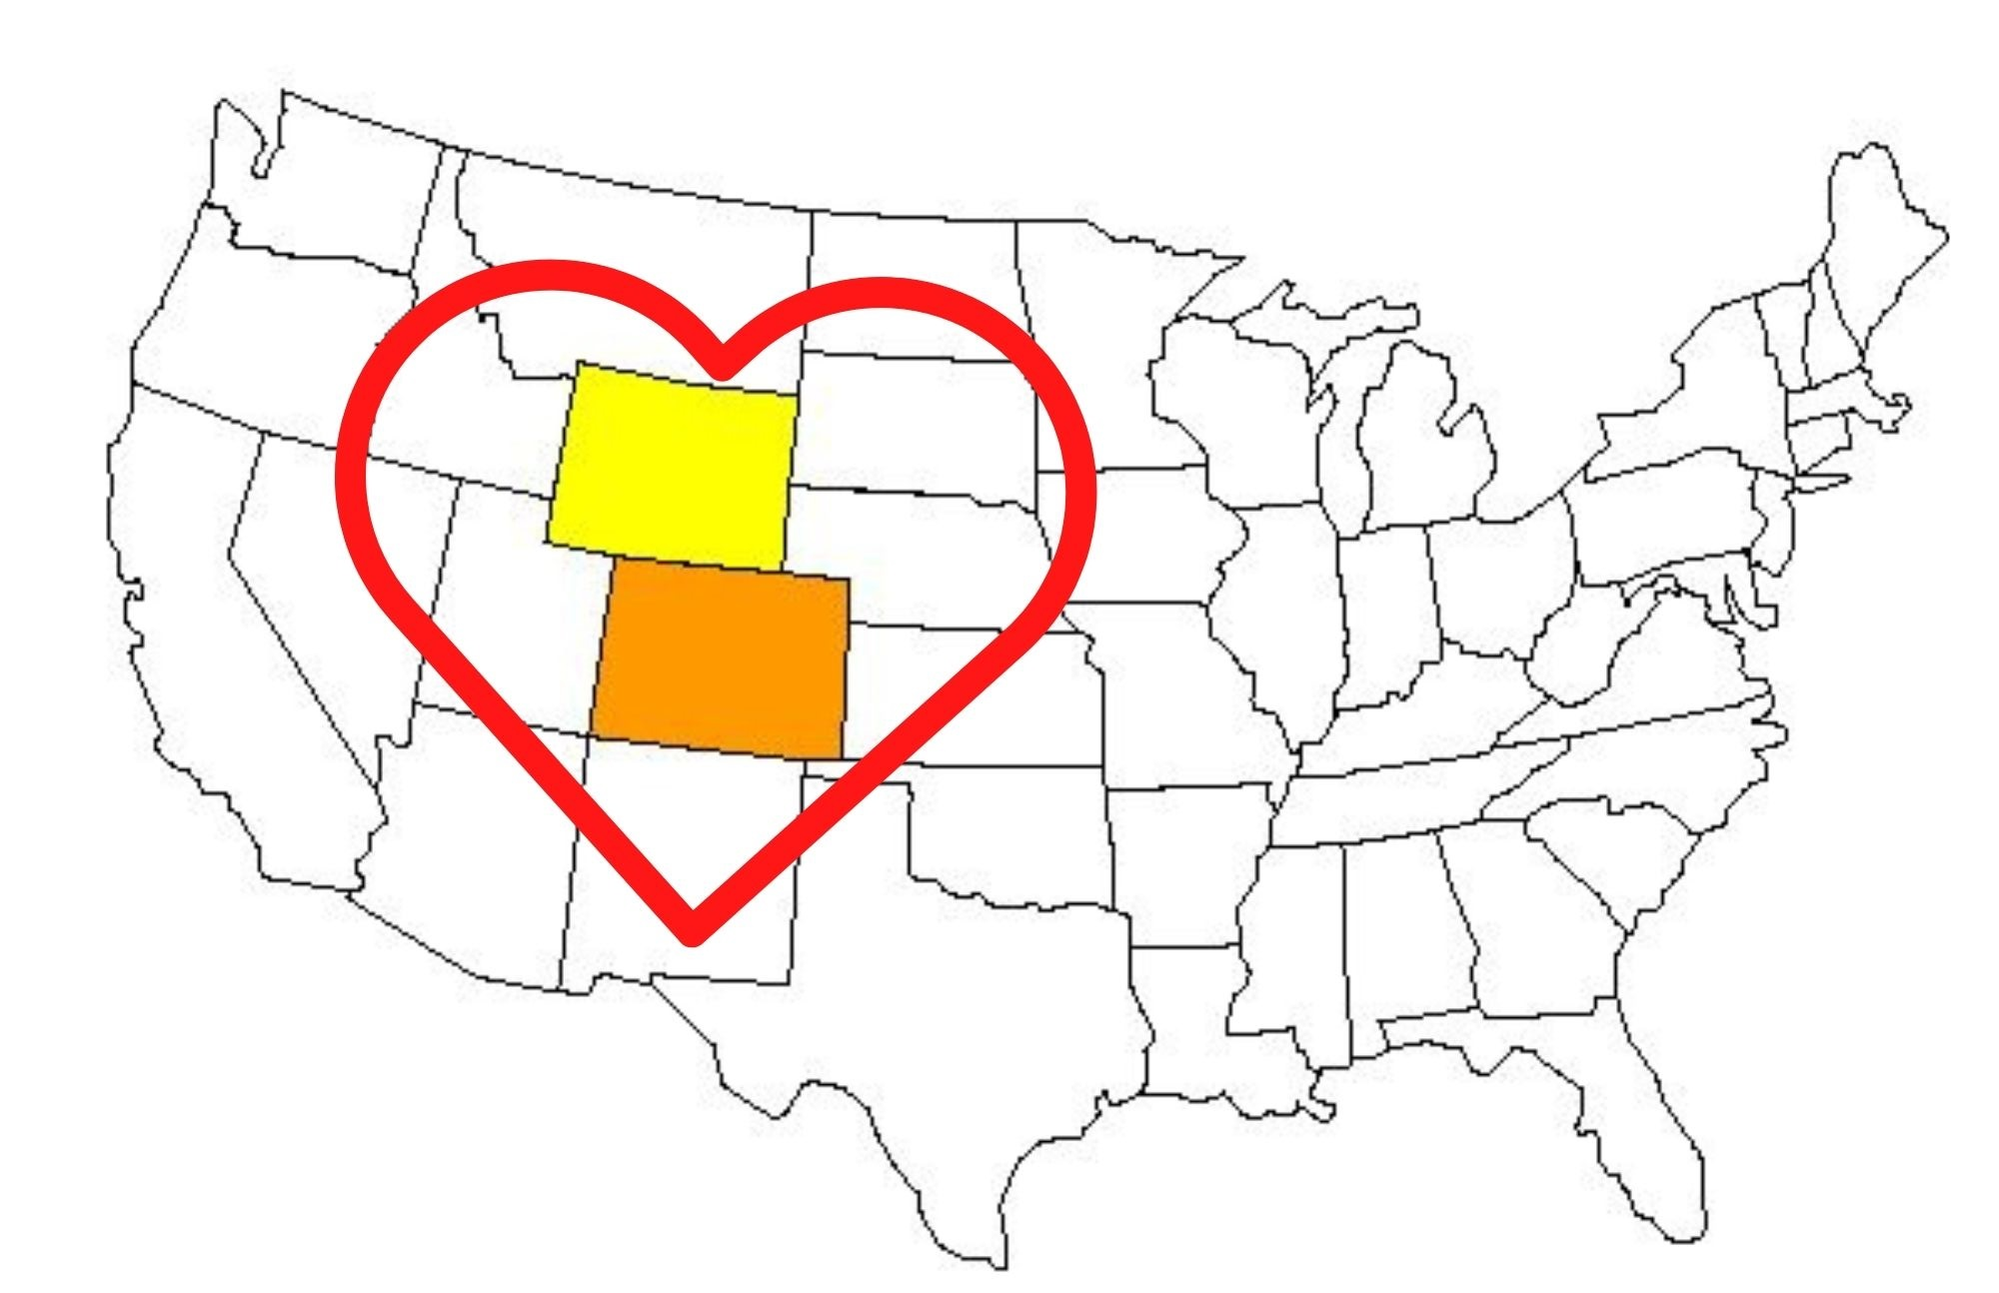
Pit Stop!
It is with heartfelt gratitude and respect that we acknowledge the Colorado School for the Deaf and the Blind (CSDB) and the Colorado Home Intervention Program (CHIP) for granting the Wyoming Early Intervention Initiative (WEII) permission to modify and use the CHIP Manual to support Wyoming families with children who are D/HH.
We could not ask for better neighbors.
Thank you!
Notes:
Nancy
A quick pit stop to acknowledge once more how fortunate WY has been to have CO as a supportive neighbor willing to share resources.

Slide 25
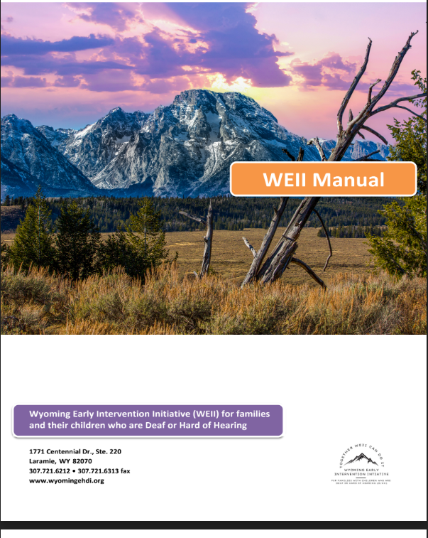
Wyoming Family Resource Manual
We combined our WY Resource Guide for Wyoming Families and the Colorado Home Intervention Program (CHIP) Manual
Notes:
Nancy
We were given permission to adapt the CHIP manual and combine it with Wyoming’s Resource Guide to facilitate the development of the WY Family Resource Manual. Core Team members worked on this project for several months and we are in the process of having our first batch of manuals printed. The printed manual is intended to be provided to families upon diagnosis either through their audiologist or through the EHDI program. Electronic copies are also made available to families and EI providers.

Slide 26
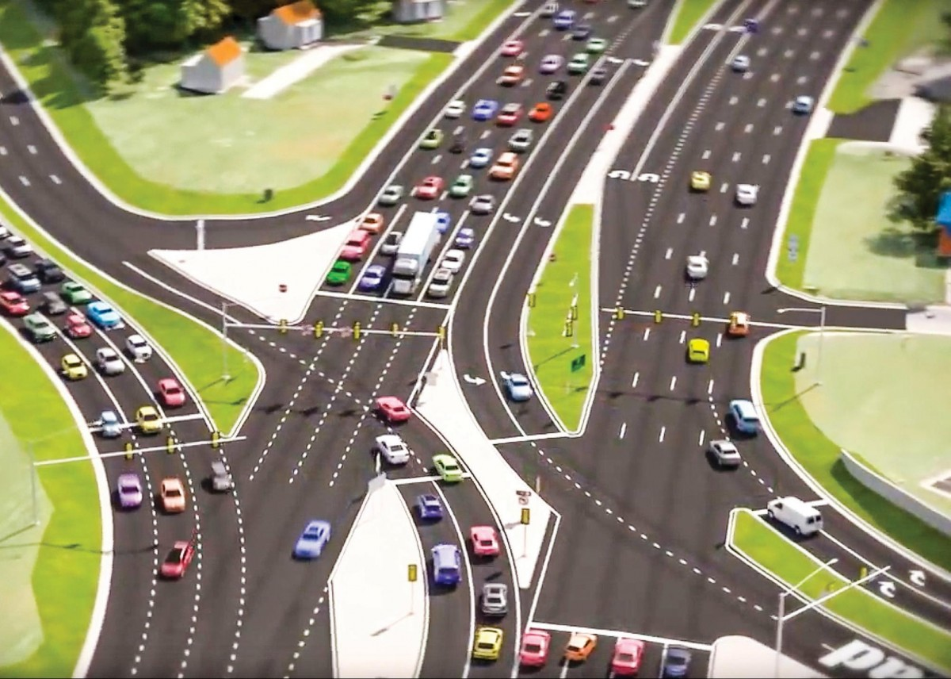
Late 2021-2022
We Arrived at an Intersection
This Photo by Unknown Author is licensed under CC BY-NC
The WEII Team Determined a Need to Support
Early Interventionists with Increased Intention
Notes:
Nancy

Slide 27
Using Our WEII Goals the Team Created a Program of Support within WEII called:
WEII Plus Program
Using training, coaching and mentoring, parents and professionals are guided and supported as they access critical information and service needed for children who are D/HH to develop to their fullest potential.
Notes:
Annette:
Prior to the start of, and during, the WEII collaboration, some direct support was provided to families through an SLP with WY Families for Hands & Voices (outside of Part C EI services). This program, Reading Early Accelerates Development, or READ Plus, received very positive feedback from families. However, it was only able to reach approximately 20-25% of families each year. Based on the needs assessment, we knew this model needed to be adapted to benefit the additional families and children. The new model is called the WEII Plus Program which utilizes training, coaching, and mentoring to guide and support families and interventionists.

Slide 28
WEII Plus Program Description
Statewide service delivery model provided through the WY Child Development Centers….working to build capacity.
Purpose: Empower early intervention providers and families by providing training, resources, strategies, and coaching specific to the diagnosis of hearing loss.
The intended outcome is that early intervention providers and families are supported in making informed decisions to give the child the opportunity to achieve their highest potential.
Notes:
Annette
Part C - needed to start small, so the focus is on Part C, but Part B is available to families upon request.
The WEII Plus Program is a statewide service delivery model provided through the Wyoming Child Development Centers and is available at no cost to Wyoming families who have children who are deaf/hard of hearing from birth through two years of age (Part C - Wyoming Department of Health, Early Intervention and Education Program).
The WEII Plus Program empowers Wyoming early intervention providers and families by providing training, resources, strategies, and coaching, specific to the diagnosis of hearing loss.
Early intervention providers and families are supported in making informed decisions to give the child the opportunity to achieve their highest potential. WEII Plus is family-centered and focuses on parents being their child’s first and most important teacher.

Slide 29
WEII Plus Program: Critical Component (the turbo boost)
Provision in contracts between Part C and the child development centers requiring that provide Part C services that interventionists who work with children who are D/HH must connect with the WEII Plus Coordinator – (As of July 1, 2022) - SYSTEM CHANGE SUCCESS! *****
JJ
Notes:
Judy
What made the difference in being able to have a statewide approach? As of July 1st of this year, there is a provision in Part C contracts between the EIEP and the Child Development Centers that interventionists will utilize the WEII Plus Coordinator as they provide EI services to children who are D/HH. The WEII Plus Coordinator is an SLP from WY Families for Hands & Voices. The WEII Plus Facilitators are EI providers throughout the state. While we are currently focused on Part C, Part B families can receive the program upon request.

Slide 30
WEII Plus Program Process
ID of child
birth - 2 who is D/HH
01
Permission from family for WEII Plus Coordinator to contact EI Providers
Referral to Part C EI and WY Hands & Voices
02
03
WEII Plus Coordinator contacts Family Service Coordinator and WEII Plus Facilitator
Family provided with WY Family Resource Manual
04
WEII Plus Facilitator given access to WEII Resources
05
WEII Plus Coordinator makes initial phone call to family to share info and schedule meeting
06
Initial meeting with family with WEII Plus Coordinator, FSC, and Facilitator
07
08
Notes:
Annette
Starts with the identiification of hearing loss in children birth through two years old.
Written permission is received by famiiles at the time of identification for the WEII Plus Coordinator to contact EI Providers (FSC and Facilitators).
Referrals to Part C EI and WY Hands & Voices by WY EHDI and audiologists While at participating Audiologists, families are provided with the WY Family Resource Manual. If families have not received a WY Resource Manual, they will receive on in the mail from the Wyoming EHDI Program. These manuals will be use during EI sessions with their early interventionist/WEII Plus Facilitator and WEII Plus Coordinator.
WEII Plus Coordinator connects with the FSC and the WEII Plus Facilitator (usually an SLP)
The WEII Plus Coordinator makes the initial contact wiht the family to share info and schedule meetings.
Finally the initial meeting with the family and the WEII Plus Coordinator, FSC, and WEII Plus Facilitator is held.
WEII Plus Facilitator has access to WEII Resources - Manual, Padlet, Scope and Sequence. These will soon be discussed in more detail.

Slide 31
WEII Plus Program: The Gears in Motion
WEII Plus Coordinator –
SLP who specializes in working with young children who
are D/HH - Wyoming Families for Hands & Voices
WEII Plus Facilitators –
Interventionists at the Wyoming Child Development Centers
ASL Instructors -
Work with families: Contracted by the WY Child Development Centers
LSL Coach -
Supports the Facilitators: Provided by the WEII Core Team
Notes:
Annette

Slide 32
WEII Plus Program: Under the Hood
WEII Plus Facilitators identified in each CDC Region Speech language pathologists or Teachers of the
Deaf
Generally SLPs are already on staff, TODs may be added
These facilitators are funded by the Child Development Centers
Initial on-boarding of WEII Plus Facilitators:
Trainings held virtually annually or more as needed
Notes:
Annette:
The Facilitators in each region, will be SLP. TOD or ED Aud.In Wyoming we have larger CDC’s that will always have D/HH children in their centers and others that will have one every few years.
Talk specifically about the WEII Plus facilitator check ins, collaborative training with Coloraod

Slide 33
WEII Plus Program: Under the Hood
ODDACE assessments
Accountability for developmental progress
Inform IFSP goals and outcomes
WEII Plus Coordinator meets to coach and mentor Facilitators
Regular check ins and trainings (1:1 or with families)
Two collaborative state-wide trainings with Colorado
October 2022 Dual Diagnosis - Deafness and Autism
April 2023 Creating a Reading Child
Notes:
Annette:
The Facilitators in each region, will be SLP. TOD or ED Aud.In Wyoming we have larger CDC’s that will always have D/HH children in their centers and others that will have one every few years.
Talk specifically about the WEII Plus facilitator check ins, collaborative training with Coloraod

Slide 34
WEII Plus Program Resources Developed to Support Facilitators
WEII Plus Scope and Sequence
WEII Plus Facilitator Manual
WEII Plus Padlet
Listening and Spoken Language Coach
ASL Curriculum and Resources
Initial Family Packets - bilateral loss, unilateral loss, Spanish and English
Children’s books through the Wyoming Library for the Deaf
Notes:
Annette

Slide 35
WEII Plus Program Resources Developed to Support Facilitators
WEII Plus Scope and Sequence
Fillable Form
Links to Padlet
Resources
Documentation of Topics Discussed with the Family
Notes:
Annette and Julie

Slide 36
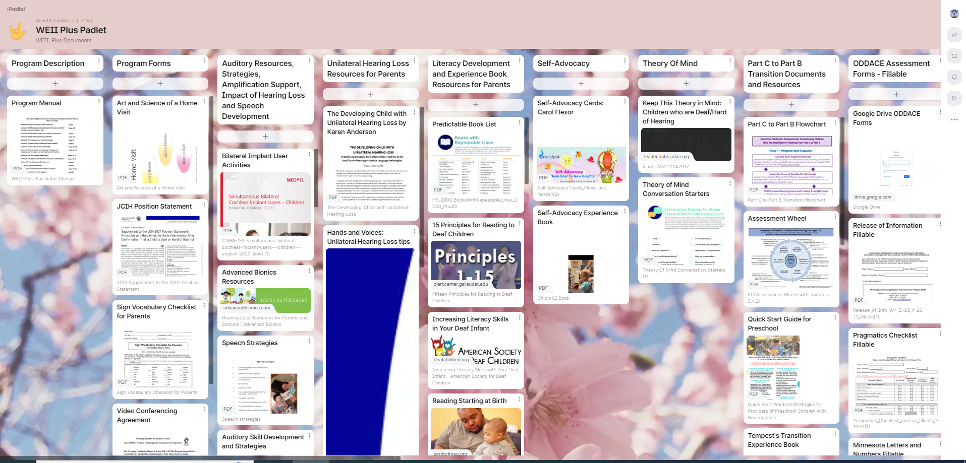
More WEII Plus Program Resources Developed
Link to Padlet
WEII Plus Padlet – Digital sharing platform for our facilitator with their resources placed in one location and easily accessible.
Notes:
Julie
The online padlet contains information in these different areas.

Slide 37
Even More WEII Plus Program Resources Developed
WEII Plus Facilitator Manual
Facilitators being mentored in this subject matter
Notes:
Annette
Facilitators,will be mentored and trained in these areas

Slide 38
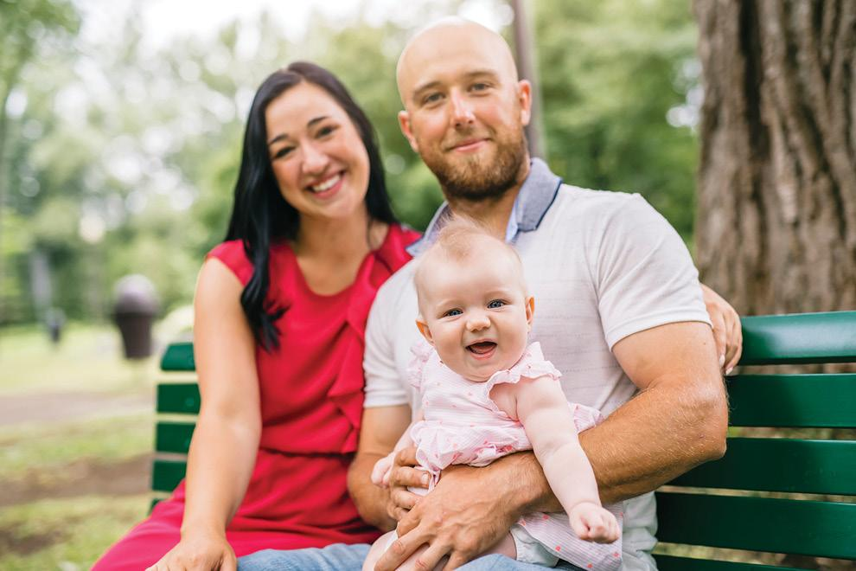
WEII Plus Program Supports Families
Focus on families’ communication choices and literacy
Family participation in ODDACE assessments
Mentoring and coaching for families by the WEII Coordinator in Collaboration with the WEII Facilitators.
Family advocacy support
Connections to Parent Guides
Connections to D/HH Role Models
Advocacy, Support, and Training (ASTra)
This Photo by Unknown Author is licensed under CC BY-SA-NC
Active family participation is critical and fostered!
Notes:
Julie with Betsy support
As we all know the participation and cooperation of the parents is very critical. Families will be referred to EI and the WEII plus coordinator who will connect with the CDC and the family

Slide 39
Communication
Choices Support
Listening and Spoken Language Coach
ASL Curriculum and Resources
What have we accomplished … so far
We have implemented many resources, strategies and supports this year
Initial Family Packets have been created
155 ODDACES have been completed since September, 2020
Literacy Focused Intervention
State-wide training
Children’s books through Wyoming Library for the Deaf
167 Joint home visits with the WEII Plus facilitators since July 1, 2022
10 Monthly WEII Plus facilitator check-ins since July 1, 2022
Notes:
Annette will have final numbers of ODDACE assessments and facilitator visits by May 19

Slide 40
CHALLENGES… so far
Getting and keeping stakeholders on board - persistence
Progress takes time and is not always linear
Developing and maintaining a cohesive core team
Getting and keeping CDCs and EI providers on board
Providers and Administrators Understanding the need for and benefits of specialized EI
WY EI providers may only work with a children who is D/HH every few years
Desire for a boots on the ground position in the EI Department Specific to Children who are D/HH
Families understanding the importance and urgency of EI
Notes:
Annette and Nancy
Some of our challenges:
Creating and maintaining a cohesive core team,
Personnel time covered by collaborating agencies and organizations - no large fiscal note attached,
Getting and keeping state stakeholders on board- persistence,
Buy in from state administrators,
Getting and keeping child development centers on board
Utilizing developed resources and processes from other jurisdictions

Slide 41
Timeline Overview
Start
2019-2020
Vision
SWOT and Partner
Commitments
Baseline Outcomes
Evaluation
Drilldown on ODDACE Data
and Submit a Proposal to Governor’s Office
Logic Model
Plan
Begin work on Year Two Goals in Small Groups
2021-22
5 Goal Small Group Work Begins
Begin to Develop WEII Plus
Adding ASL Instructor and LSL Coach
Meet to Develop Year 2 Goals
Self Assessments
2022-23
WEII Plus
Connection into Part C Contracts
Meet to Review
Year One
WEII Plus Roll Out July 1st 2022
2020-21
Notes:
Cheryl and Nancy - The process

Slide 42
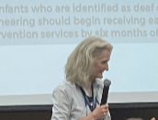
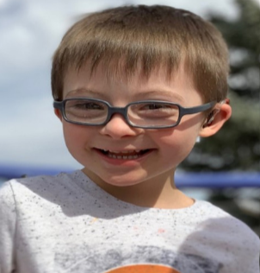
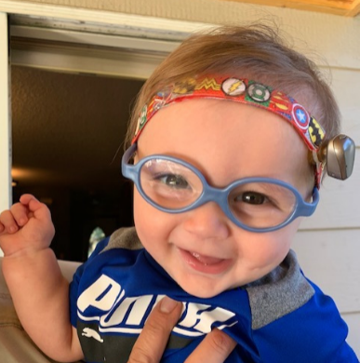
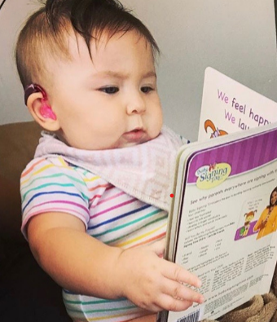
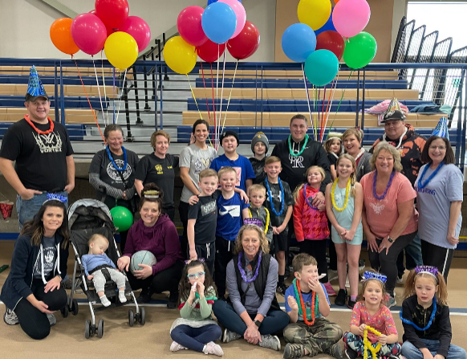
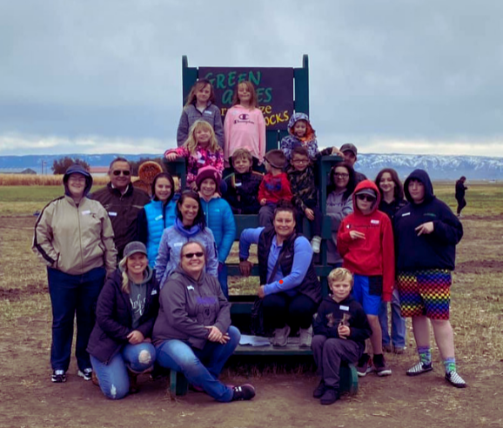
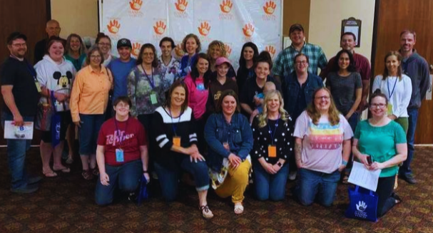
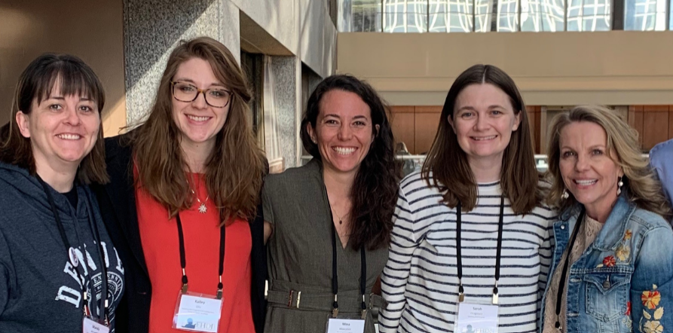
This is our “Why”... to impact families and the providers who support them!
Notes:
Nancy
Creating and maintaining a cohesive core team, Personnel time covered by collaborating agencies and organizations - no large fiscal note attached, Getting and keeping state stakeholders on board- persistence, Buy in from state administrators,Getting and keeping child development centers on board
Utilizing developed resources and processes from other jurisdictions

Slide 43
The Road Goes on Forever!
This Photo by Unknown Author is licensed under CC BY-SA-NC
We have more plans!
Notes:
Nancy
We are going to continue to build statewide capacity. We are collecting data and drafting a

Slide 44
This Photo by Unknown Author is licensed under CC BY-SA
Thank you!!
Notes:
Nancy and all

Slide 45
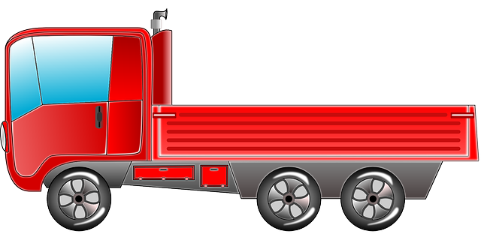
Additional Information to Take Home inlcuding Our Contact Information
WEII

Slide 46
Activity Time!
This Photo by Unknown Author is licensed under CC BY-SA-NC

Slide 47
Contact Information
Annette Landes, WEII Plus Coordinator,970-217-9532, annette@wyhandsandvoices.org
Nancy Pajak, Marion Downs Center, 307-721-6212, nancy.pajak@wyo.gov,
Judy Juengel, Part C Coordinator, 307-777-8762, judy.juengel2@wyo.gov
Betsy Tengesdal, betsy.tengesdal@gmail.com

Slide 48
Contact Information
Christie Fritz, Wyoming Department of Education, Deaf/HH Outreach Services, christie.fritz@wyo.gov
Sarah Fitzgerald: Wyoming EHDI Program, Co-Coordinator, 307-399-2889, sarah.fitzgerald@wyo.gov
Wendy Hewitt: Wyoming Families for Hands & Voices, Executive Director, 307-780-6476, wendy@wyhandsandvoices.org
Kim Reimann: Wyoming Families for Hands & Voices, Assistant Director/Guide By Your Side - Program Coordinator; CDC+ Audiology - Parent Advocate/Family Educator, 307-258-0967, kimr@wyhandsandvoices.org
Cheryl Johnson, Ed.D.: Marion Downs Center, Consultant, cheryl@colorado.edu

Slide 49
Desired Outcomes of WEII
Families and practitioners know how to access the resources for accurate appropriate information.
Information is available in an easily accessible format.
Data informs intervention decisions and practices to improve early intervention on the individual and statewide level.
Progress monitoring is sustainable statewide using the ODDACE in addition to the state of Wyoming mandated list of approved/recommended child development assessments.
Families are aware of and participate in family-based trainings and support opportunities.
Families know of essential resources in Wyoming and can utilize them.
Families, early intervention providers, childcare providers and other essential persons to the child’s development understand appropriate use and implications of hearing technology.

Slide 50
More Information about our 5 Goals
Notes:
Wendy

Slide 51
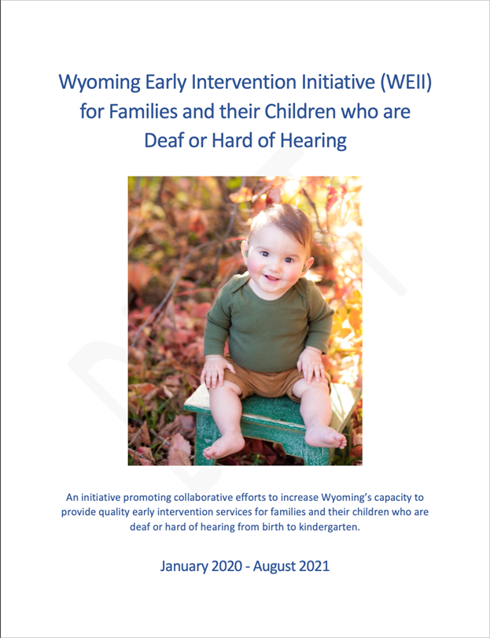
Goal 1: Communication
Increase awareness of and access to available resources and services for young children who are deaf or hard of hearing and their families.
WEII Report - January 2020 - August 2021
Needs Assessment
First Year of Progress
Organized quarterly meetings
Agendas
PowerPoint presentations
Tracked progress on goals and activities
Notes:
Sarah
As we all know communication is important. Highlights of this goal include the WEII Report - comprehensive report that covered everything completed during first year and a half of the project.
Organized stakeholder meetings
Tracked and shared progress for the small working groups

Slide 52
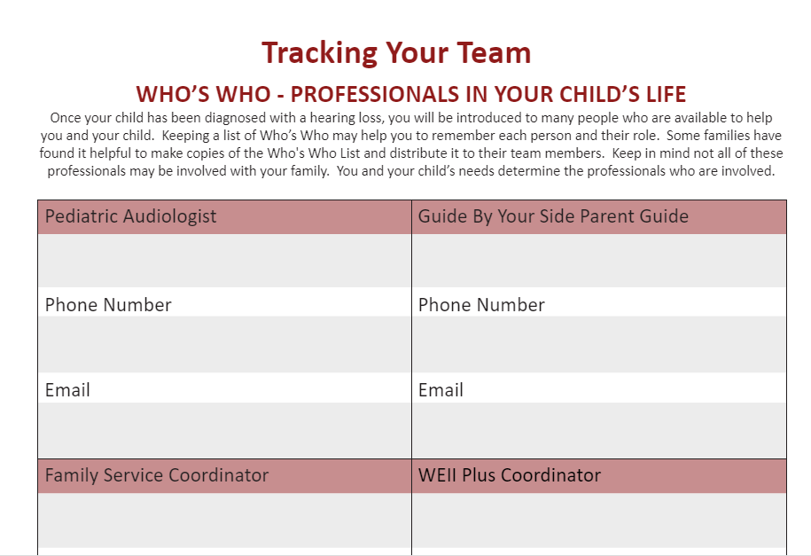
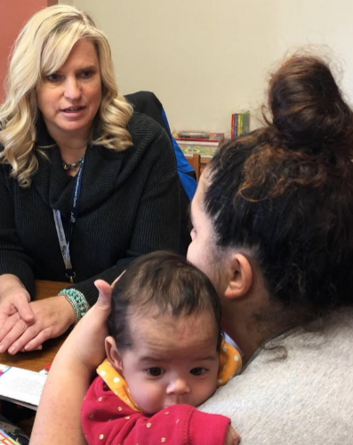
Goal 2: Family to Family Support …
Create a system in which families who have children who are deaf or hard of hearing (from birth to kindergarten) are consistently made aware of and have the ability to utilize available resources in Wyoming.
Who’s Who Form
Online Resources
Advocacy, Support, and Training (ASTra)
January 2021
November 2022 - upcoming
Annual Wyoming Families for Hands & Voices Parent Training
Notes:
Kim
Goal 2: Family to Family Support.
We wanted to address ways to help support families, to ensure that they knew where to go for the specific support they may be seeking and how to utilize the resources made available to them in Wyoming.
Families are continuously made aware of supports and resources through visits with their Parent Guides, while at the audiology appointments, connections with professionals such as teachers of the deaf, slps, and through online resources. All of our vetted online resources will be or are already house on the Department of of Education Outreach Services for the D/HH website, the WY EHDI website and WY Families for Hands & Voices website.

Slide 53
Goal 2: Family to Family Support …
Quick Start Guides
What I Wish I Had Known When My Child was Diagnosed with Hearing Loss: A Life Saver From One Parent to Another
Practical Strategies for Families of Infants who are D/HH
What is Early Intervention?
Assistive Listening Devices
Practical Strategies for Daycare Providers of Infants with Hearing Loss
Tips for Preparing for Your Infant’s/Toddler’s Individualized Family Service Plan (ISFP) Meeting
Notes:
“Quick Start Guides” were created to address several different topics around raising children with hearing loss.
While these Guides are included in the Wyoming Family Resource Manual
For Example: The goal of the Life Preserver“Guides” is to help families understand that they are not alone on this journey; of feelings they might experience - that it is normal for moms and dads to express themselves differently than one another, the importance of building connections. Follow through etc.
All of these Quick Start Guides are intended to support families and professionals.
As stated earlier in the presentation, all of these Guides have been uploaded to the Whova App.

Slide 54
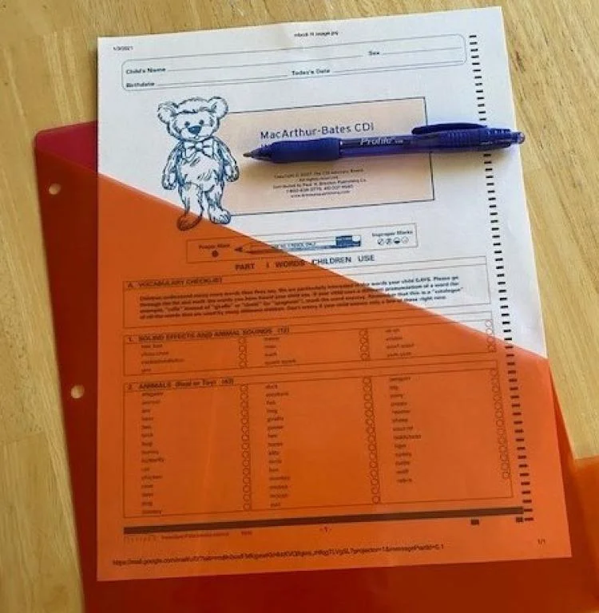
Goal 3: Progress Monitoring
WY children receiving early intervention will have access to and participate in a uniform/statewide system for gathering and analyzing developmental outcome data for children who are deaf/hard of hearing from birth to kindergarten.
Data will be used to inform intervention decisions and practices to improve early intervention on the individual and statewide level.
Notes:
Standardized developmental assessment results for individual children allow parents and interventionists to monitor a child’s progress over time and identify potential delays at their outset. Additionally, results from the assessment data can be used to generate IFSP/IEP goals and to provide a data-driven approach to educational programming decisions.
Progress monitoring will be sustainable statewide as evidenced by the addition of the ODDACE to the list of approved/recommended child development assessments as mandated by the state of Wyoming.

Slide 55
Goal 3: Progress Monitoring…
ODDACE - Outcomes and Developmental Data Assistance Center for EHDI Programs
Standardized assessment completed every 6 months starting at 9 months of age up to age 3
Annual assessment from ages 3 to 5
Centers for Disease Control and Prevention (CDC) funding to Allison Sedey - University of Colorado
From September 2020 - July 2022
93 ODDACE Assessments
46 Children
(50-60% of those receiving
Part C/B EI in WY)
ODDACE
is pronounced like “Odyssey”
Notes:
Prior to the WEII, WY participated in the NECAP and is now participating in the Outcomes and Developmental Data Assistance Center for EHDI Programs (ODDACE) in order to use standardized developmental assessments.
We started the ODDACE assessment process in 3 of the 14 CDC Regions along with some individual families outside of those Regions. These 46 children represent approximately 50-60% of WY children who are D/HH and participating in Part C or Part B EI. We are now working to expand the ODDACE assessment process statewide.

Slide 56
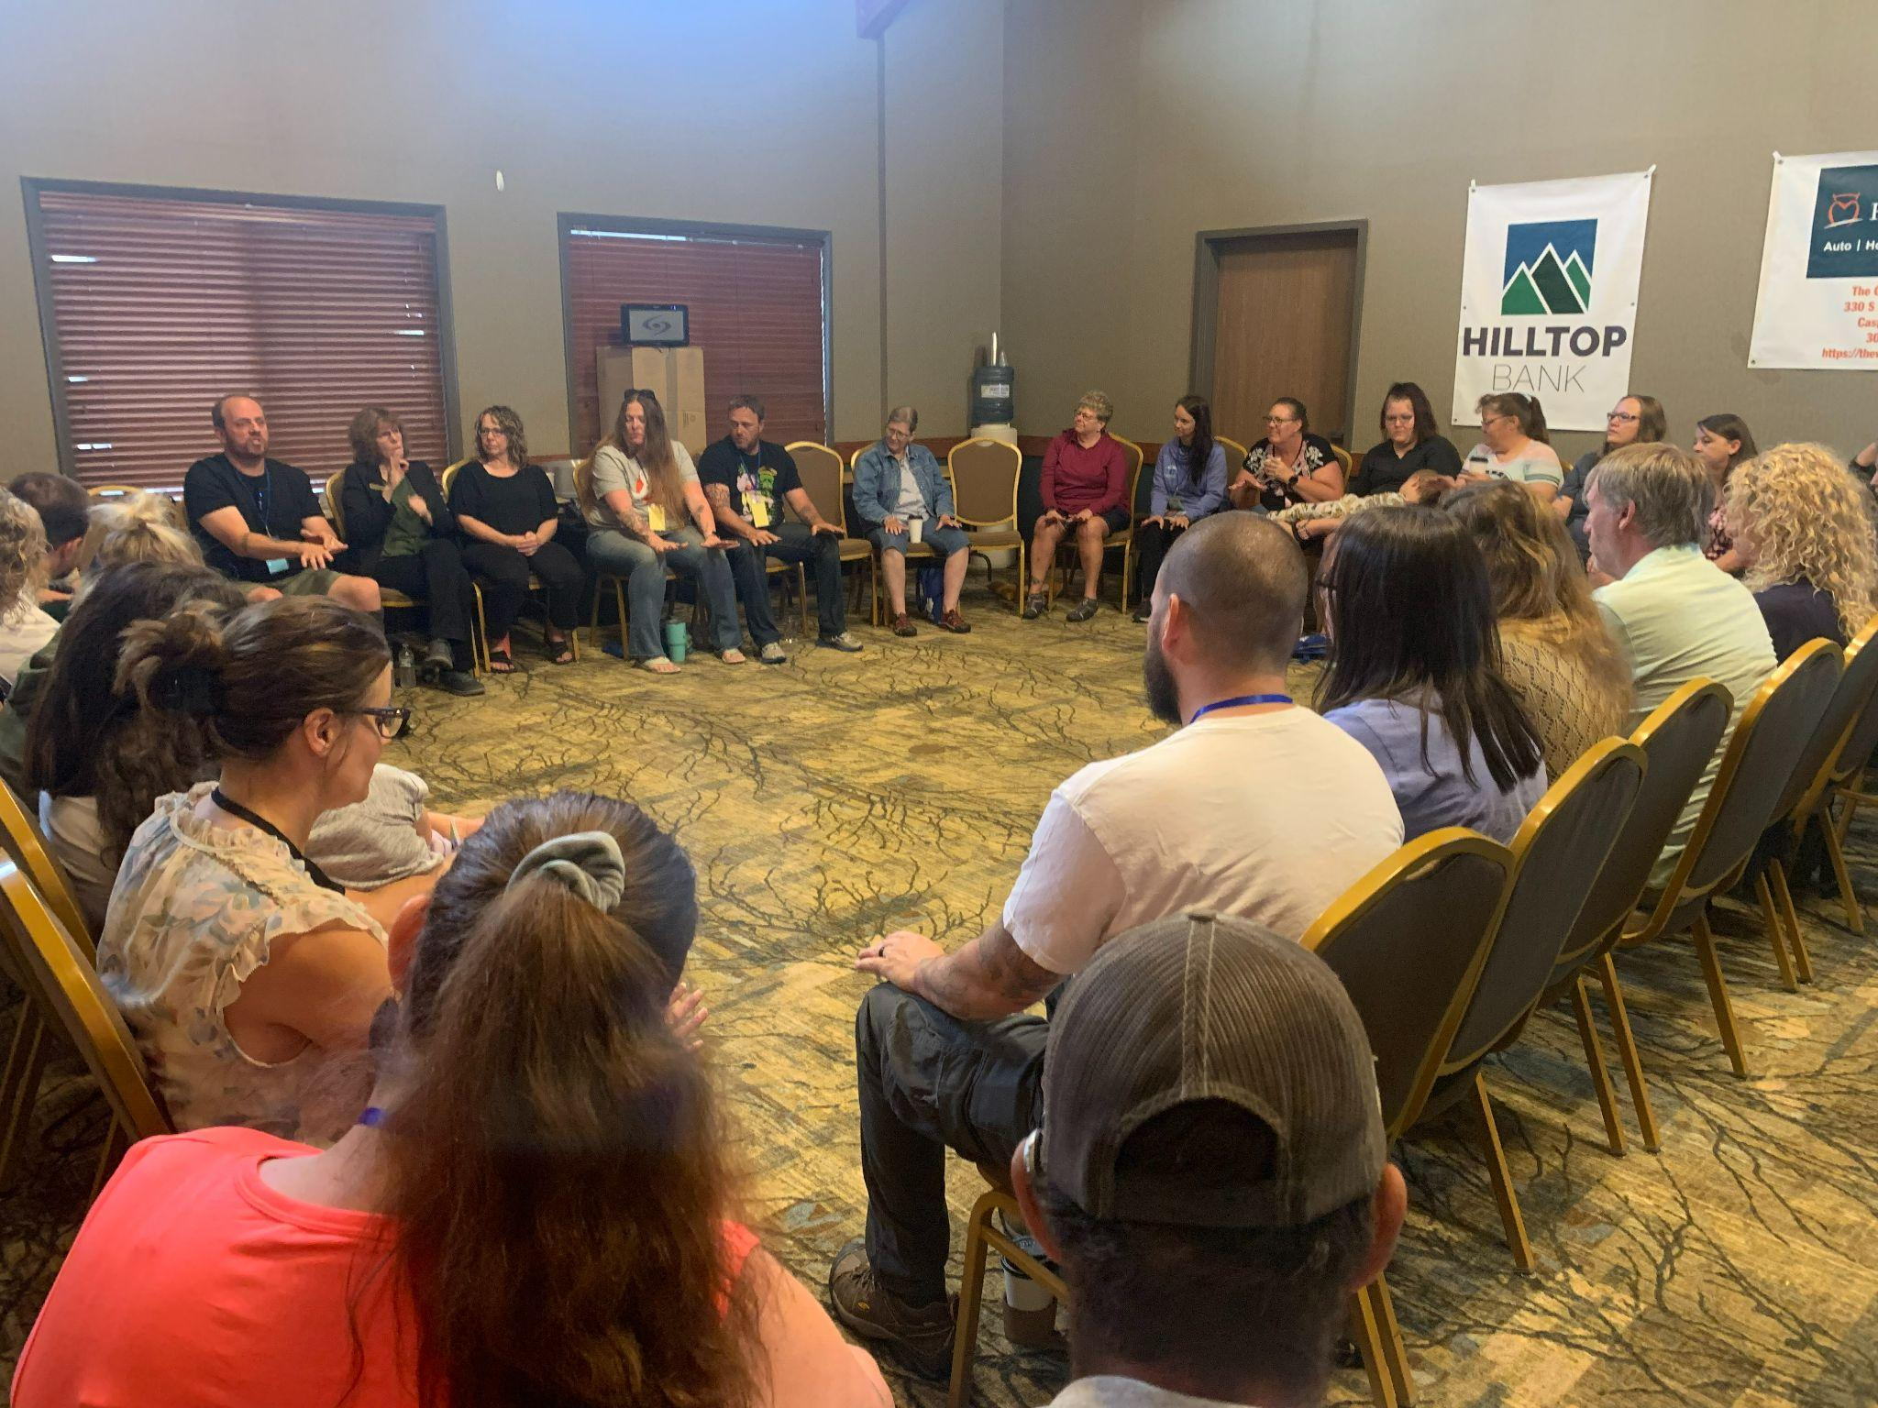
Goal 4: Professional and Parent Training
Increase family aware of and engagement in existing family trainings and supports.
Family Service Coordinator Webinars
Quick Start Guides
Assistive Listening Devices
Practical Strategies for Preschool Classroom Teachers and EI Providers of Children Who Are D/HH
Transitioning Children Who are D/HH from Part C to Part B
Advocacy, Support, and Training (ASTra)
January 2021
Annual Wyoming Families for Hands & Voices Parent Training
Notes:
Year 2 Goal: Create new trainings to address areas of need as identified by families, family-based organizations and stakeholders.Quick start guide were created to help professional and parents. HV has provided various Zoom trainings for families and professionals and the yearly parent training continues to be a great success

Slide 57
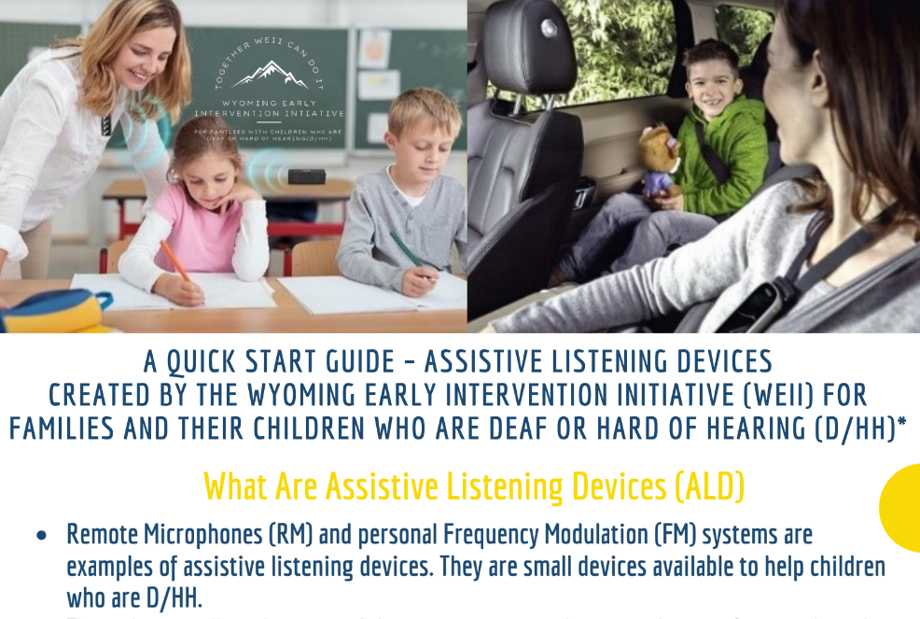
Goal 5: Hearing Technology Training
Increase knowledge and understanding on the appropriate use and implications of hearing technology by providing both online and in-person trainings and resources for families, early interventionists, and childcare providers.
Quick Start Guide - Assistive Listening Devices
Hearing Technology Videos for Families and Professionals
How to insert/remove earmold
How to know you need a new earmold
How an earmold impression is taken
Luggage Tag
Notes:
Our Hearing Technology group worked to create hearing technology videos for families and professionals, a luggage tag that can go on their child’s diaper bag with quick, helpful information about a child’s communication mode, etc., and a quick start guide on Assistive Listening Devices. What these devices do, how they are helpful, why they can be important, where to use the device.

