Slide 1
DEVELOPING A LOVE OF LITERACY:
THE IMPORTANCE OF ACTIVE LEARNING AND FAMILY ROUTINES
Luanne Stordahl
The New Mexico School for the
Blind and Visually Impaired

Slide 2
NEW MEXICO
Rural state
18 Developmental Vision Specialists
6 O&M Specialists (+6)
Large program growth:
2000: 40 kids served
2019-2020: 650 active caseloads; 945 referrals

Slide 3
BEAUTIFUL
SUNSETS!

Slide 4
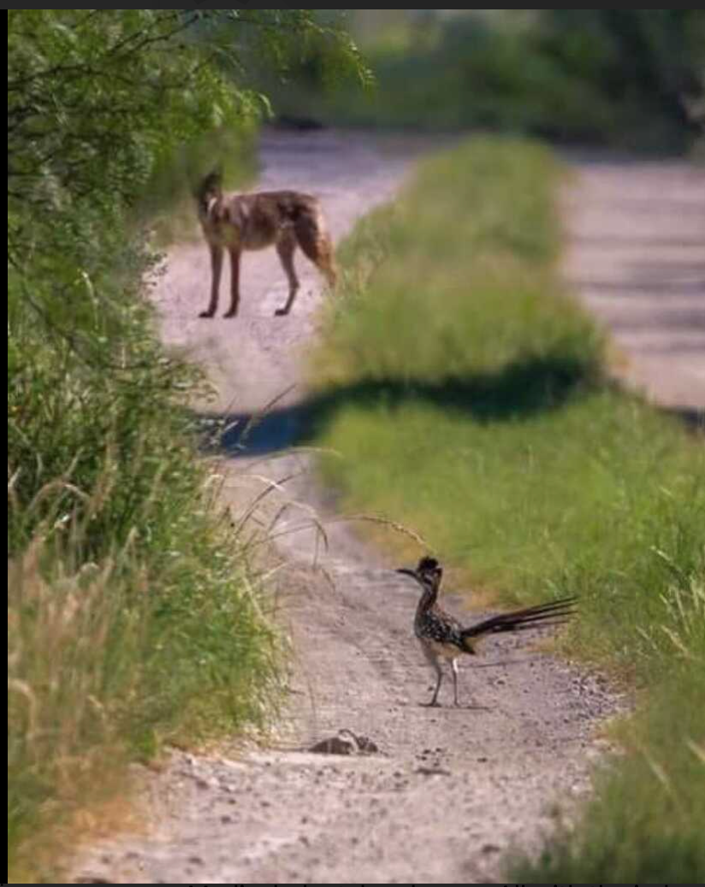
And yes ...ACME
Corporation

Slide 5
Early intervention providers are main source of referrals (including NICU)
Services are provided in the home and community
See children “at risk”
Often with children at time of diagnosis
Work closely with pediatric ophthalmologists
CVI most common diagnosis
Work as part of IFSP team/frequently co-treat with other therapists (do not have to be on IFSP to see)
Bill Medicaid for vision services

Slide 6
EARLY LITERACY: What comes to your mind?

Slide 7
DEFINITION
Literacy is the understanding that symbols represent objects, events, concepts, people, and ideas. It must be carefully taught to all children, but especially to children who are blind, deafblind or who have additional disabilities.
Majors, M. Accessing The Curriculum Frameworks Through English Language Arts; Literacy.
Notes:
There are lots of definitions out there, here’s one for your consideration

Slide 8
Literacy IS:
Communication
Concept development
Language
Listening
Relationships
Reading
Writing
Math concepts
Anticipation of events
Understanding of the world
Our experience with the world

Slide 9
Literacy is a system of communication, the ability to listen and to be heard

Slide 10
Literacy begins at birth; it doesn’t wait until a child reads her first word or until she opens her first book
1st use of hands to grasp
1st attempts to use her body to explore
1st attempts to understand her experiences
These are all parts of the process of emerging literacy, a process that takes time and varies with children
VIISA (2007)

Slide 11
ZERO TO THREE A Window to the World: Early Language and Literacy Development (2011)
“The growth and development of infants and toddlers are best supported not through a set curriculum, but rather through exploration, discovery, and the everyday activities in which they interact with adults around them.”
“A child can only achieve competency in essential school readiness skills—such as language and early literacy—when he has begun to experience and master all the domains of development. These include cognitive, social, emotional, and physical development, as well as noncognitive areas such as motivation to read and persistence in learning.”
Notes:
What I like about this is that is really talks about literacy as part of a child’s overall development. We can’t focus on literacy by itself… for our littles, it’s part of the child’s development of skills and experience with the world. We view this through the lens of the ECC for our guys

Slide 12
SENSORY EXPLORATION
Notes:
This is really the crux of what we’re going to talk about this morning. The importance of sensory exploration, ACCESS and independence within the framework of routines based services. It’s so important of focus on sensory exploration and building these skills in our little guys. It should really be the focus of what we do. In NM, we’re talking a lot about the LMA for kids under age 3 and for kids with MI…sensory exploration really needs to be our focus. Are we doing a well informed LMA for a child who has not had access to their environment? Access to tactile exploration? It’s a bigger conversation than we can have today but the development of sensory skills is a key piece of what we do from birth to 3-bith to 5.

Slide 13
GROSS MOTOR SKILLS
Movement encourages exploration
Learn about ourselves in relation to our world
Makes core, arms and hands strong
Spatial awareness
Body awareness

Slide 14
FINE MOTOR SKILLS
Developing fine motor skills helps with later reading and writing
Tactile skills are important for providing additional information and a more wholistic experience
Notes:
Long before we teach braille, we need to strengthen arms and hands and teach fine motor skills

Slide 15
Long before children can exhibit reading and writing production skills, they begin to acquire some basic understanding of concepts about literacy and its functions
Through play and life experiences, they learn to use symbols, oral language, pictures, print, and play in a coherent mixed medium; creating and communicating meanings in a variety of ways
Notes:
Through play and life experiences… we hope that’s what we’re doing… encouraging play and experiences in the family

Slide 16
By creating a language-rich environment full of meaningful early experiences, we can create a SOLID foundation for literacy skills
Notes:
If experiences are not meaningful, learning will not be meaningful. For a child to be engaged, the experience must meaningful and motivating or you won’t get engagement. No engagement…no learning. Bruce Perry says the brain develops in a use dependent way…. They need to be engaged and a part of the experience. Let’s look at some of the foundational skills or “crucial concepts” for literacy

Slide 17
CRUCIAL LITERACY CONCEPTS (Expanded Core Curriculum)
Body awareness (body parts)
Environmental awareness
Awareness of object characteristics (big, little, hard, soft, colors)
Time awareness
Spatial awareness (body in space, location words, O&M)
Actions/movement concepts (O&M)
Notes:
Environmental: their home, extended family, daycare, that places exist outside of their homes TIME: not 1:00, but NOW, FINISHED, NEXT, TODAY

Slide 18
Quantity (numbers, counting)
Symbol awareness
Emotional and social awareness
Hall (1982)

Slide 19
Create WHOLE experiences (Lowfeld)
Relate experiences wherever possible (seed/tree, cooking/shopping/farm)
Essential early vocabulary (left, right, up, down, in front of, behind, open, close) *O&M
Mangold suggested using adjectives during play that children might later encounter in reading materials (bumpy, smooth, soft, hard, rough, light, heavy, new, old, fast, slow, happy, sad, big, little, loud, quiet)
Notes:
In our work, we know the importance of creating whole experiences for kids… the eggs don’t magically appear on the plate. We want to related experiences wherever possible based on the developmental level of the child. It might a field trip to the grocery store with dad to locate and buy the eggs…. Could be the chicken on the family farm…. If your parent is reading a book about a

Slide 20
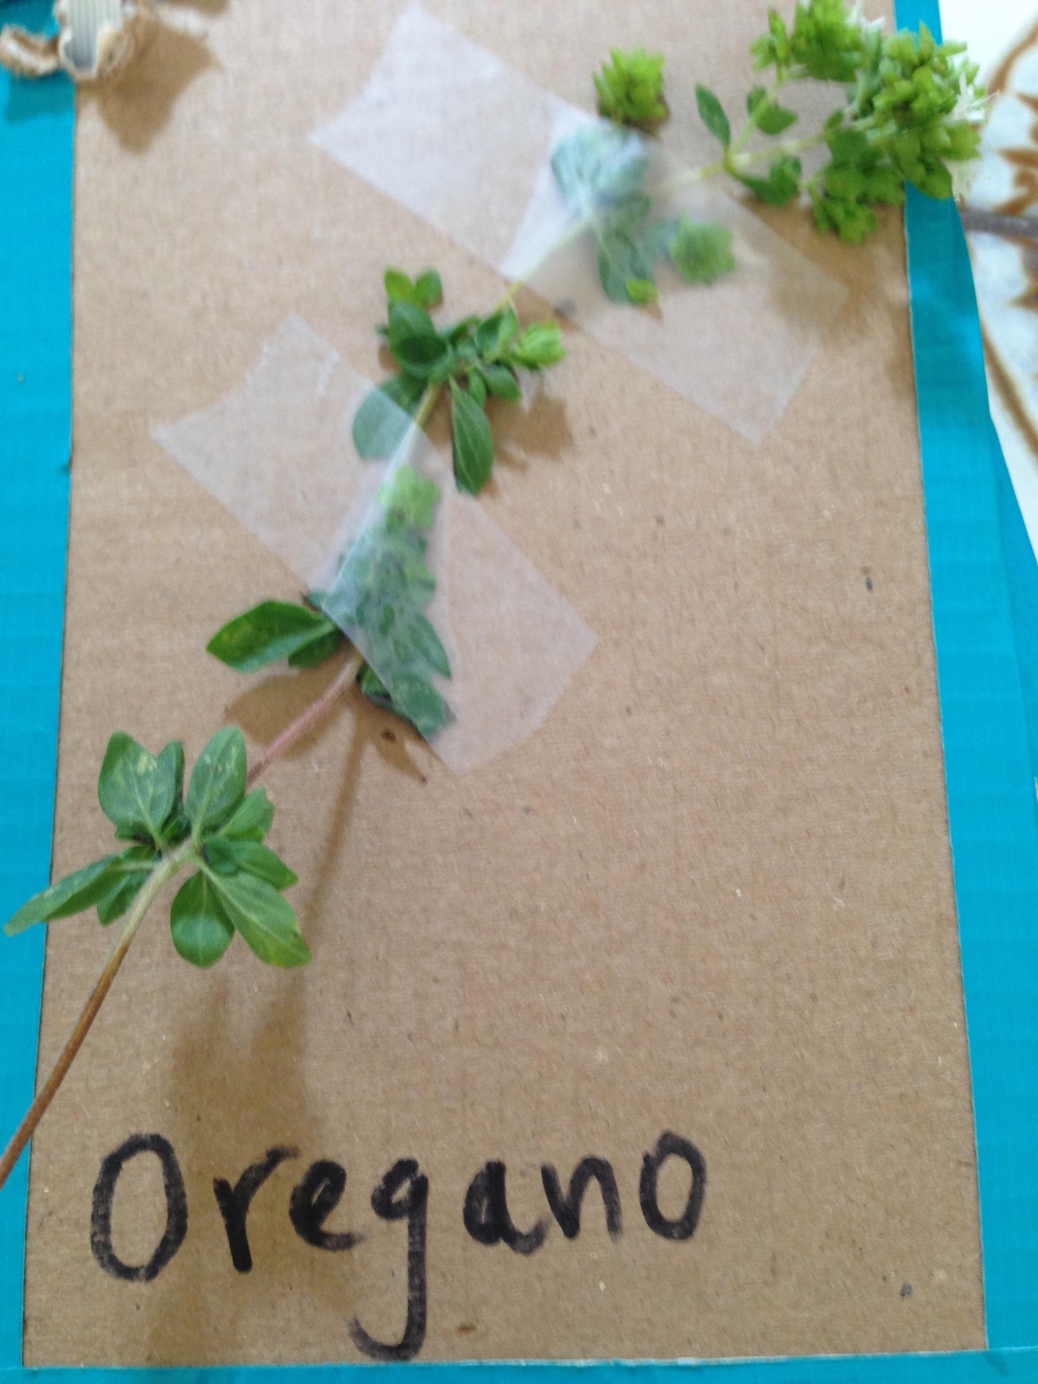
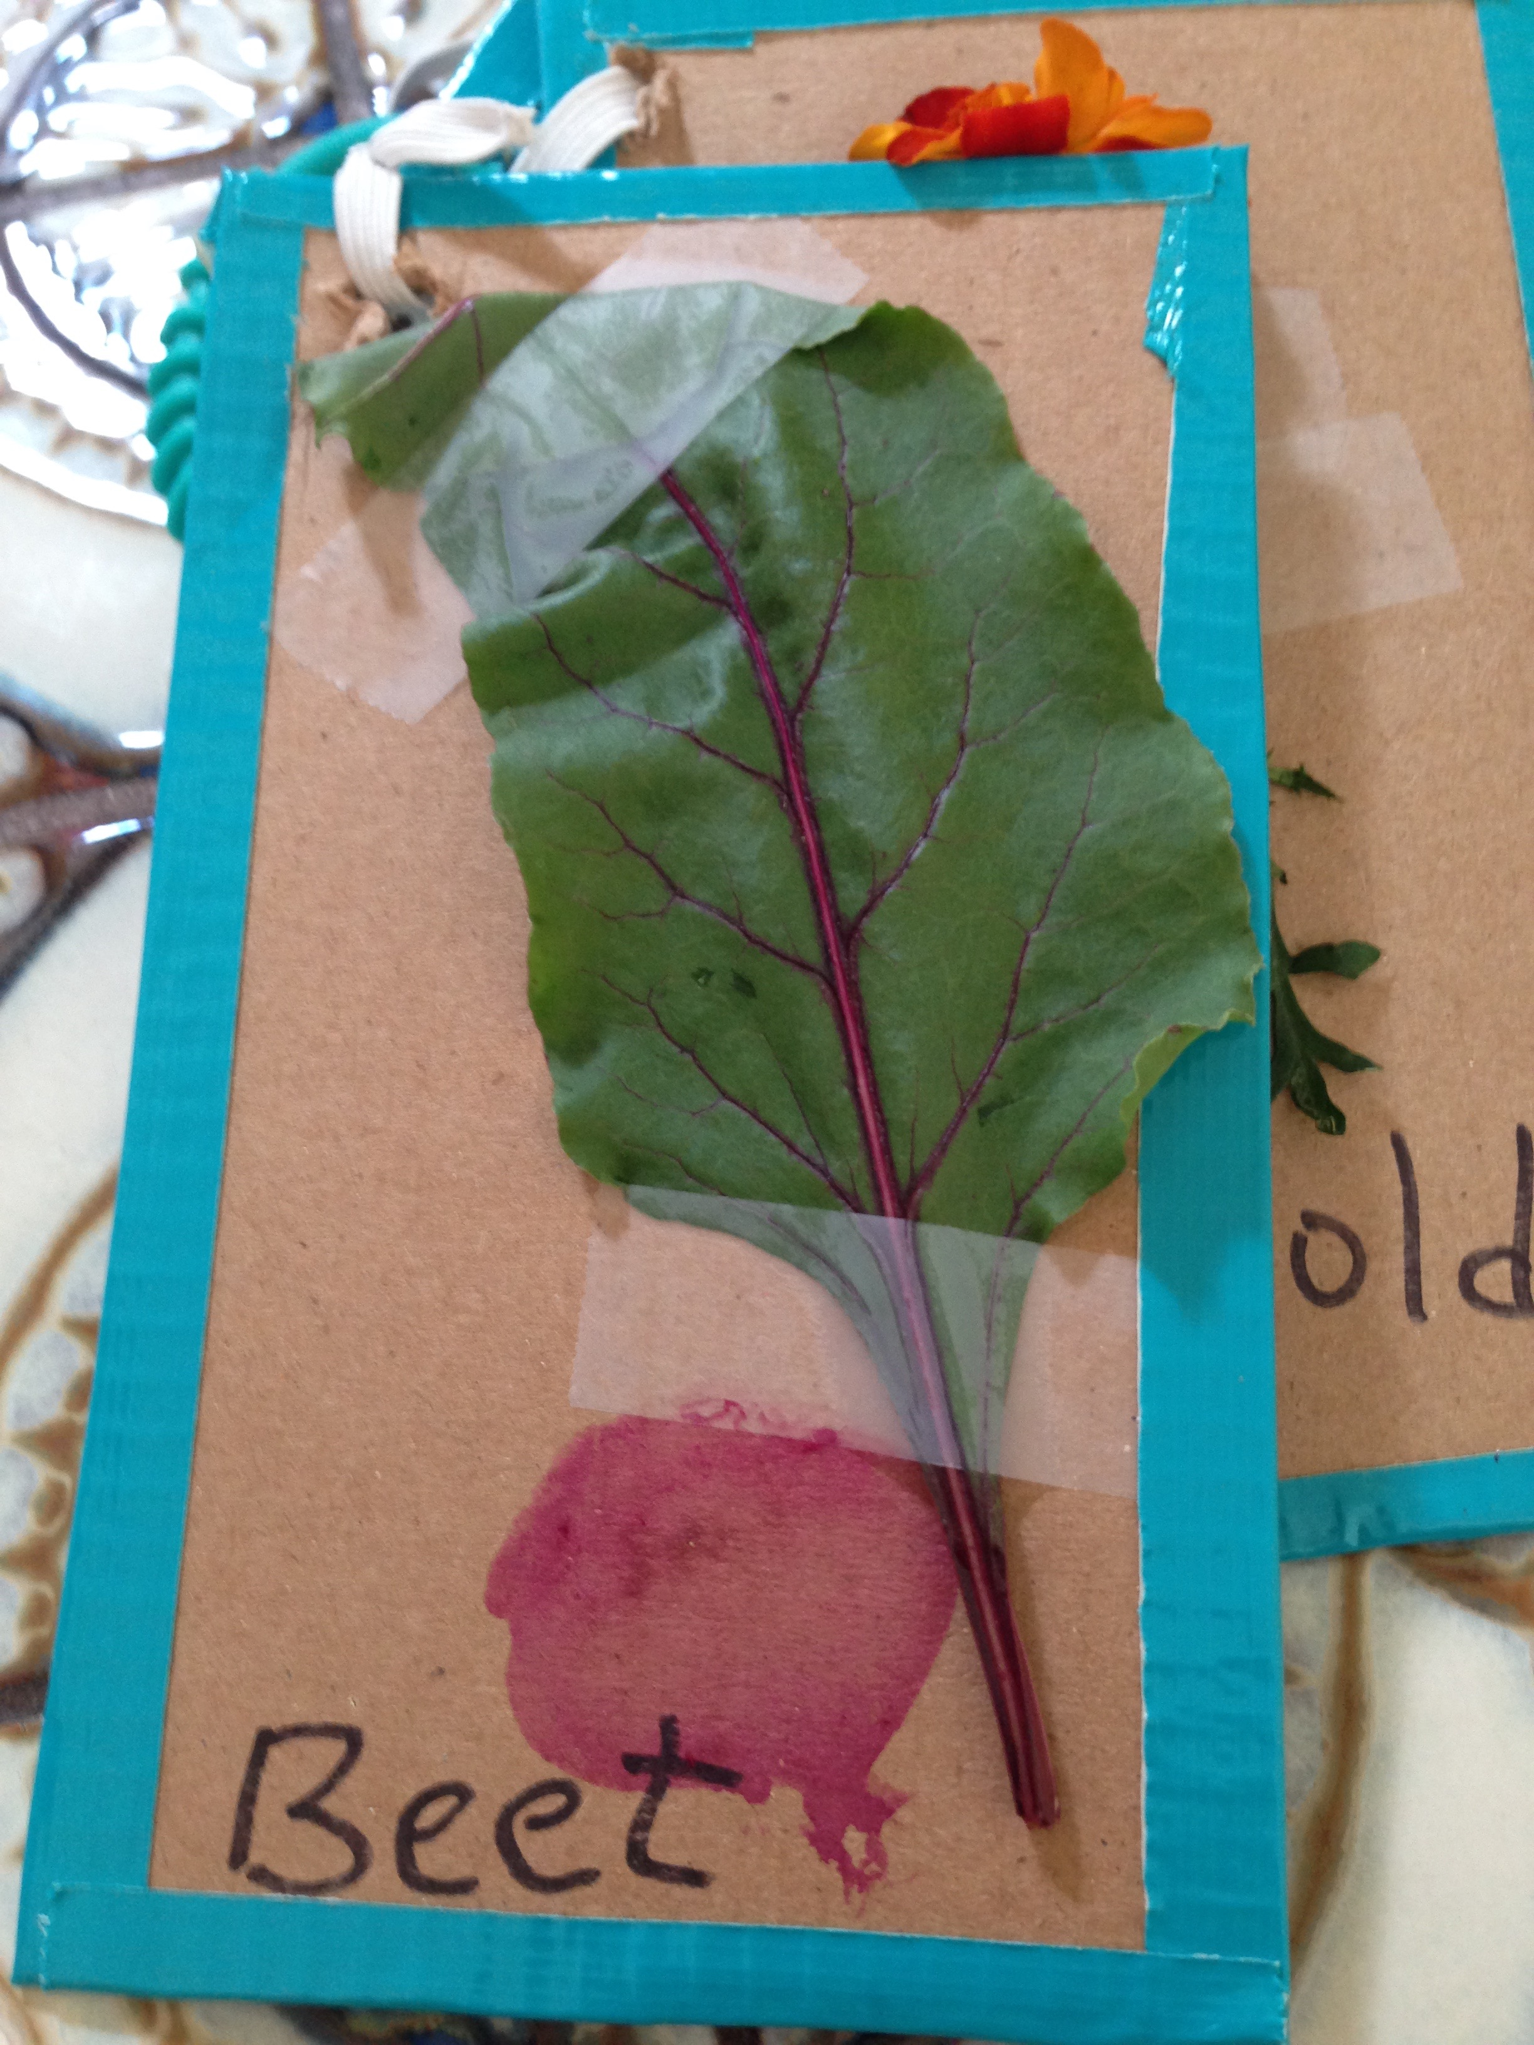

Slide 21
READ ALOUD
“The single most
important activity for
building the knowledge
required for eventual
success in reading,
Is reading aloud to children.”
Anderson, Heibert, Scott and Wilkinson, (1985)

Slide 22
Children with visual impairments are less likely to be read to by parents and caregivers
Children with visual impairments are less likely to be familiar with books and how they work
ACCESS is limited to reading materials in the home and in the community
Braille and tactile books are not typically found in the homes of young children, nor in the community
Notes:
Braille books for eye doctor offices. There’s wonderful TED talk by Ron McCallum… blind adult, attorney who lives in Australia. He talks about being one of three children and the only child who was blind

Slide 23
“I find being read to by machines a very lonely process. I grew up with family and friends reading to me and I love the warmth and the breath and the closeness of people reading.”
- Ron McCallum

Slide 24
READING
Print/Braille and book awareness
Use books found in the home (modify as needed)
Use favorite books of siblings
Make homemade books (story about child, about family, outings, experiences)
Twin vision books
Song books
Request books (food, drink, toys)
Storytelling (with child participating)

Slide 25
WRITTEN LANGUAGE
Decreased access to appropriate materials (slate/stylus, braillewriter)
Decreased attention to writing activities during play
Delayed fine motor skills
Decreased incidental learning opportunities
May be tactually defensive

Slide 26
WRITING ACTIVITIES
Scribble in pudding, yogurt
Window markers on light box/windows
Braillewriter/Mountbatten
Slate/Stylus
Golf tee (ground tip) in Styrofoam
Label everything!
Screen boards
Puff paint or Wiki Sticks
Cookie sheet
“Write” books with child
Paintbrushes/chalk outside

Slide 27
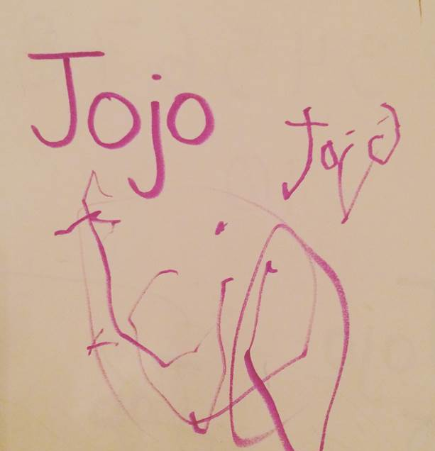

Slide 28
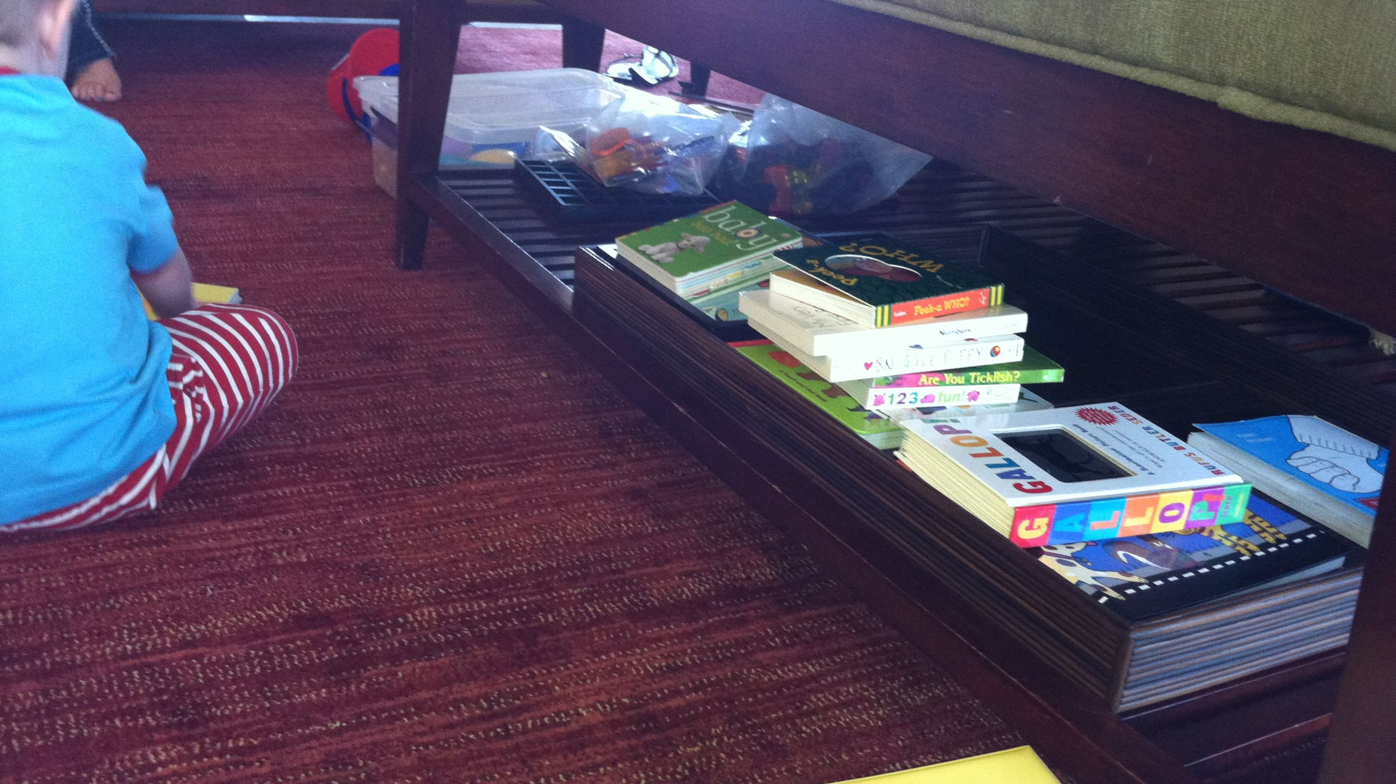
ACTIVE LEARNING THROUGH ACCESS!!!

Slide 29
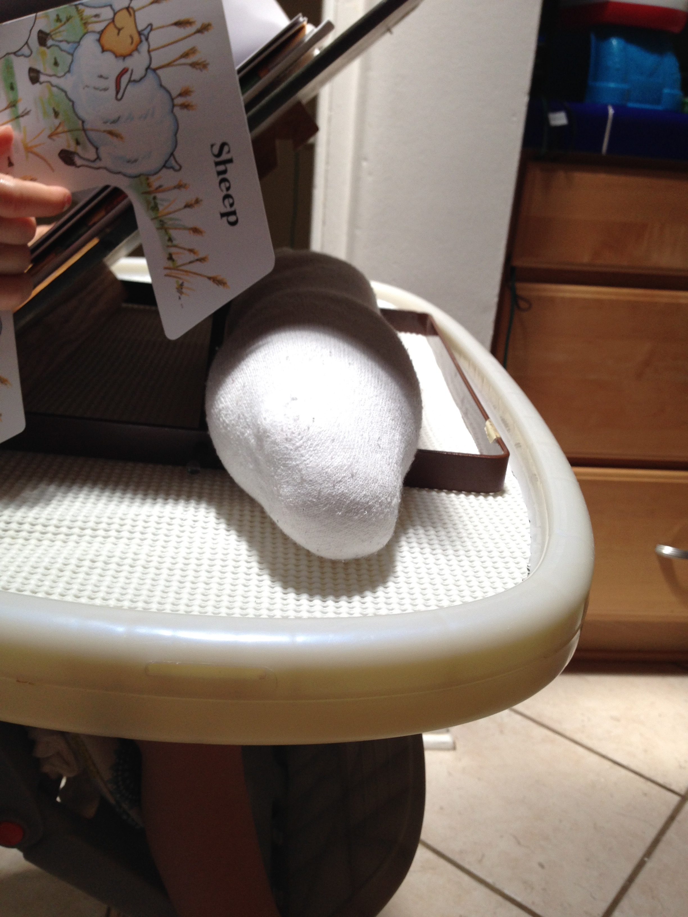

Slide 30
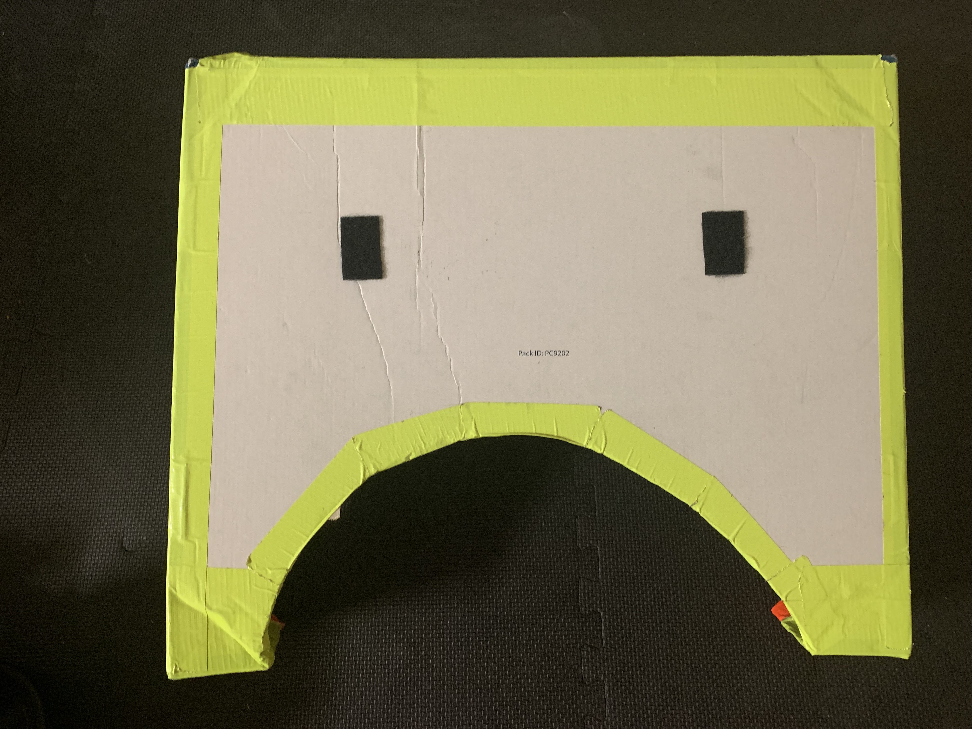

Slide 31
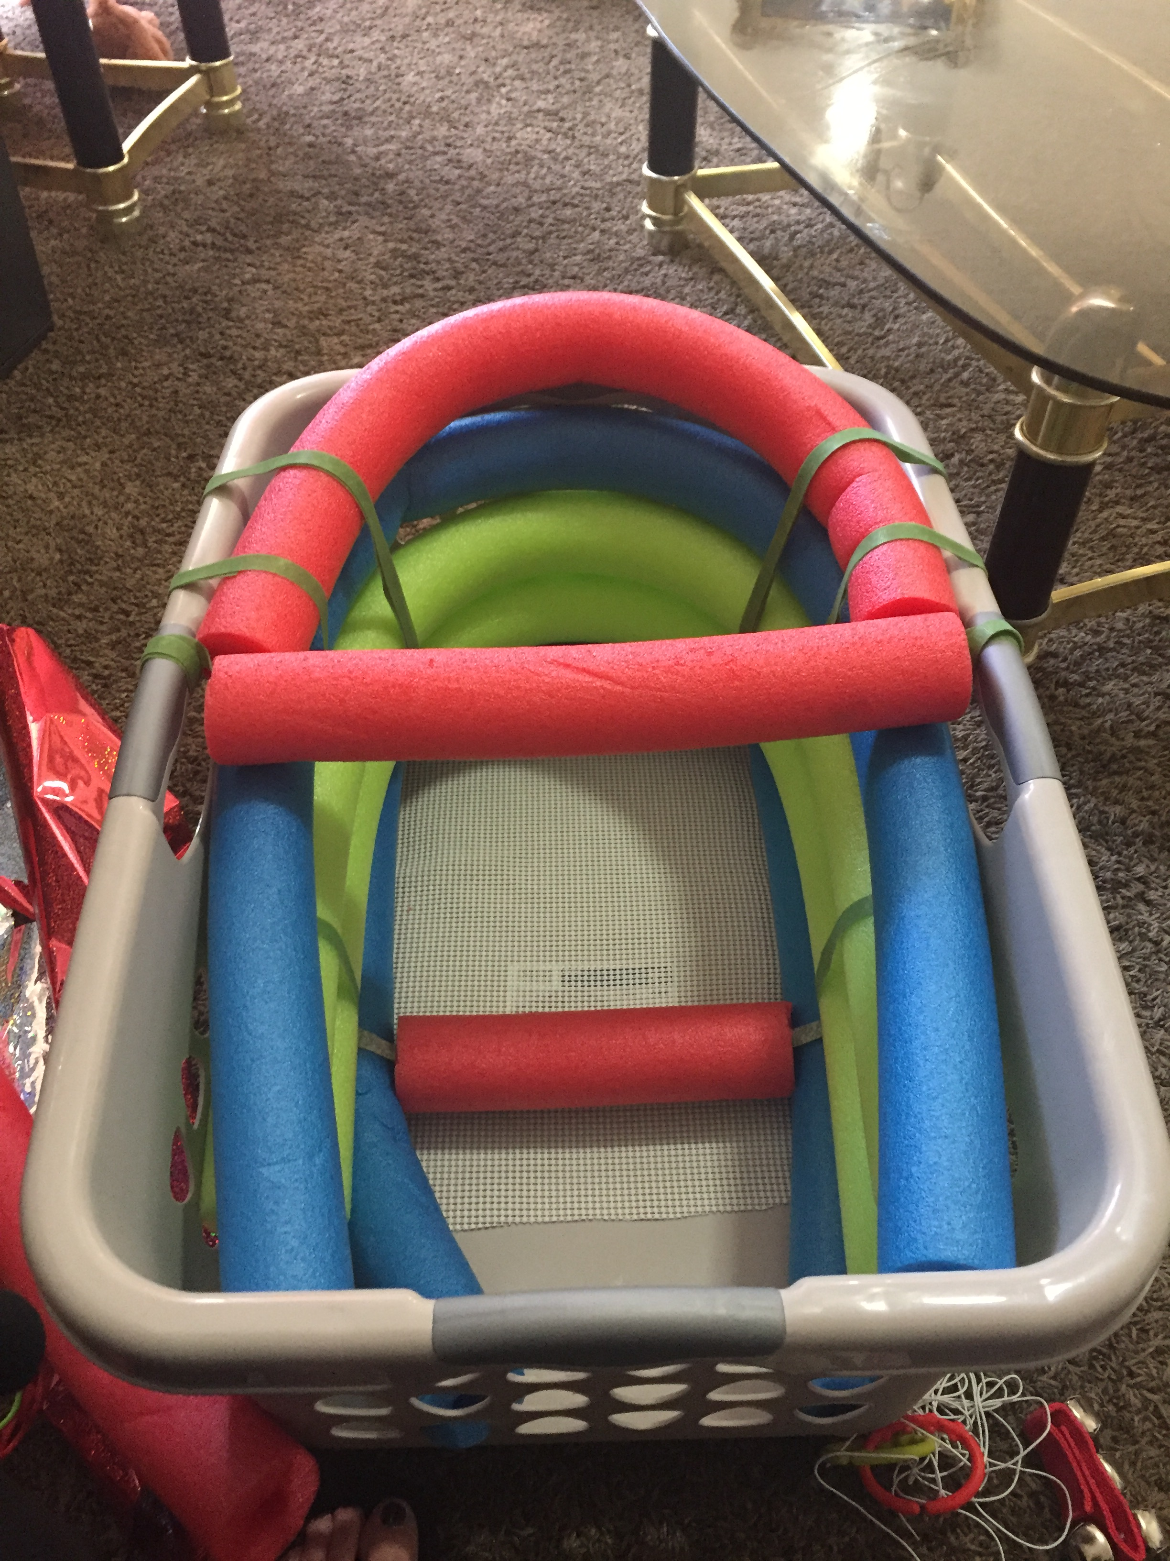

Slide 33
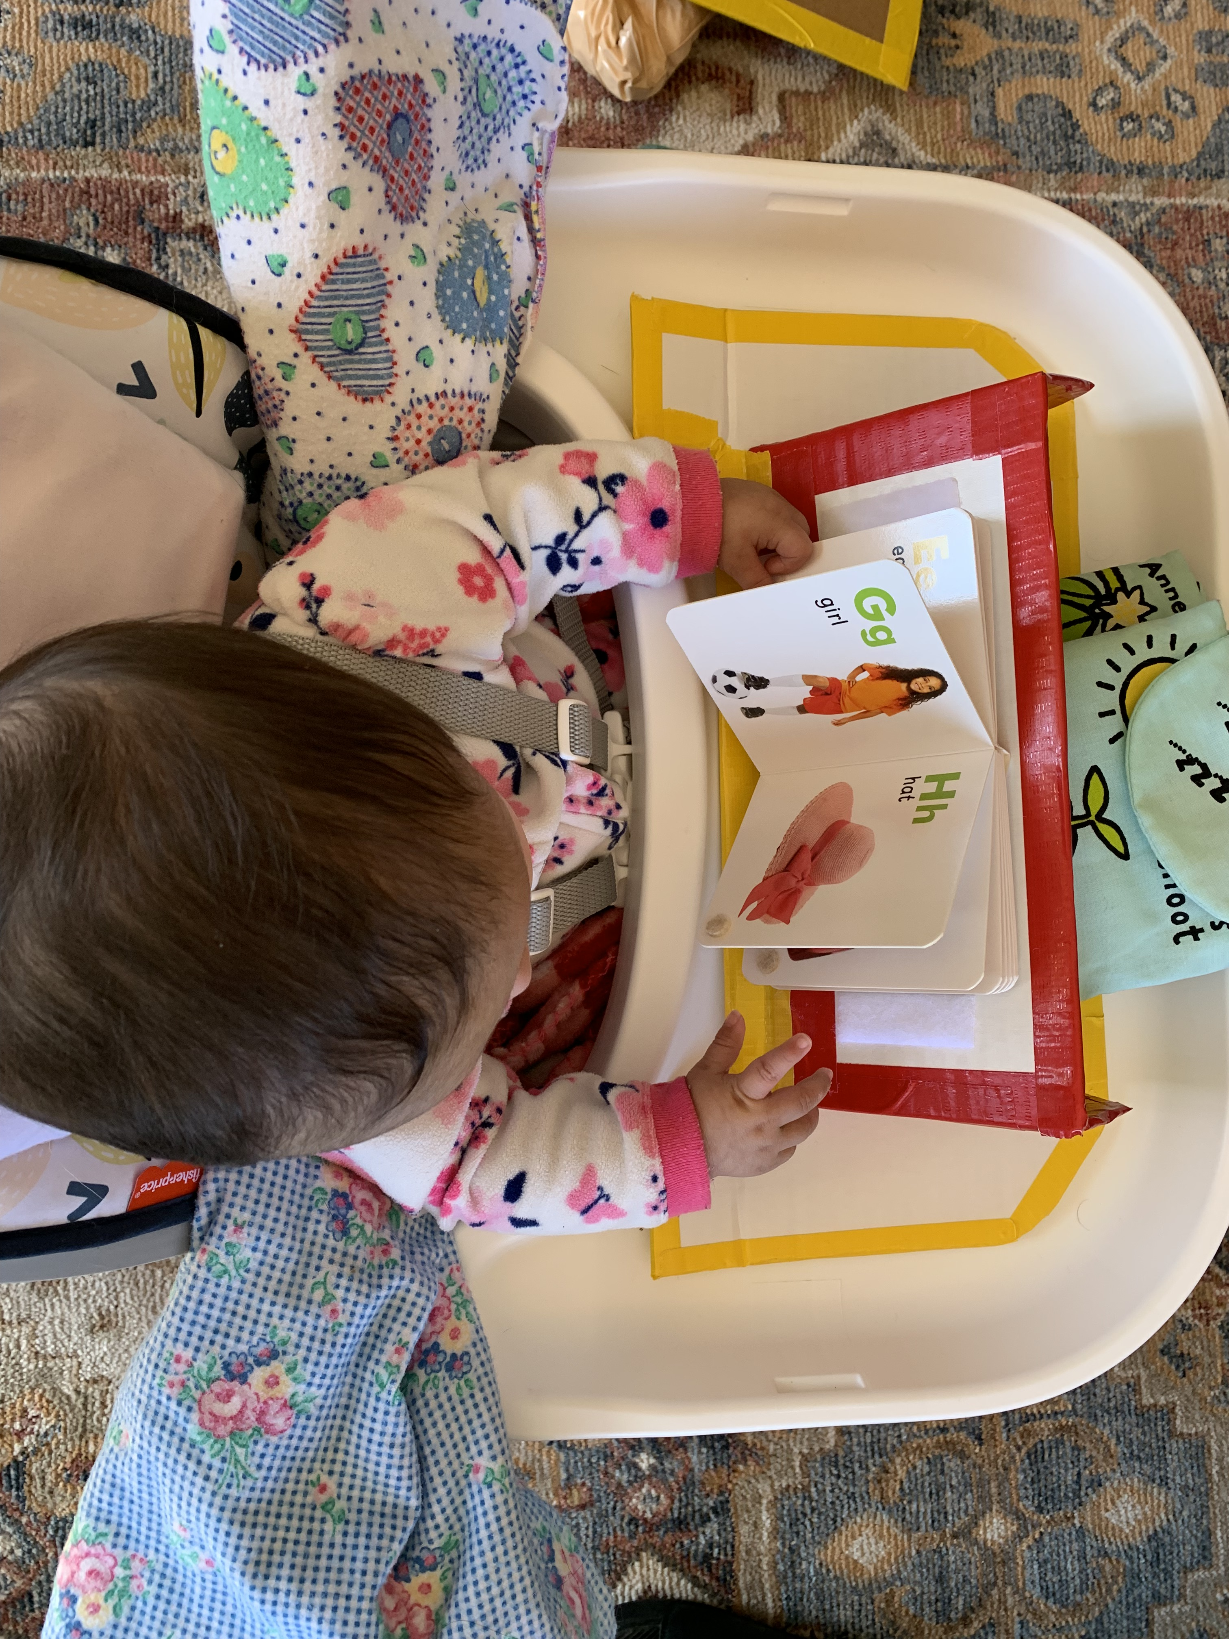
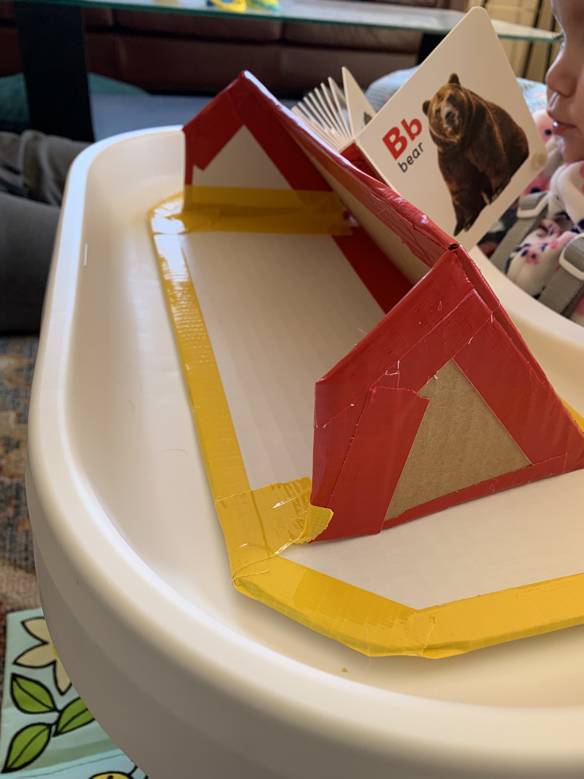

Slide 34
From Passive to Active
Children need to be
ACTIVE LEARNERS
The activities that support early literacy are those in which children commonly engage in. We can extend, increase focus and recognize these opportunities to help all children learn new skills in all areas of development

Slide 35
USE WHAT’S AVAILABLE AND INTERESTING TO THE CHILD! Follow their lead and expand on their natural desire to play and explore!
***Einstein never used flashcards!!!***

Slide 36
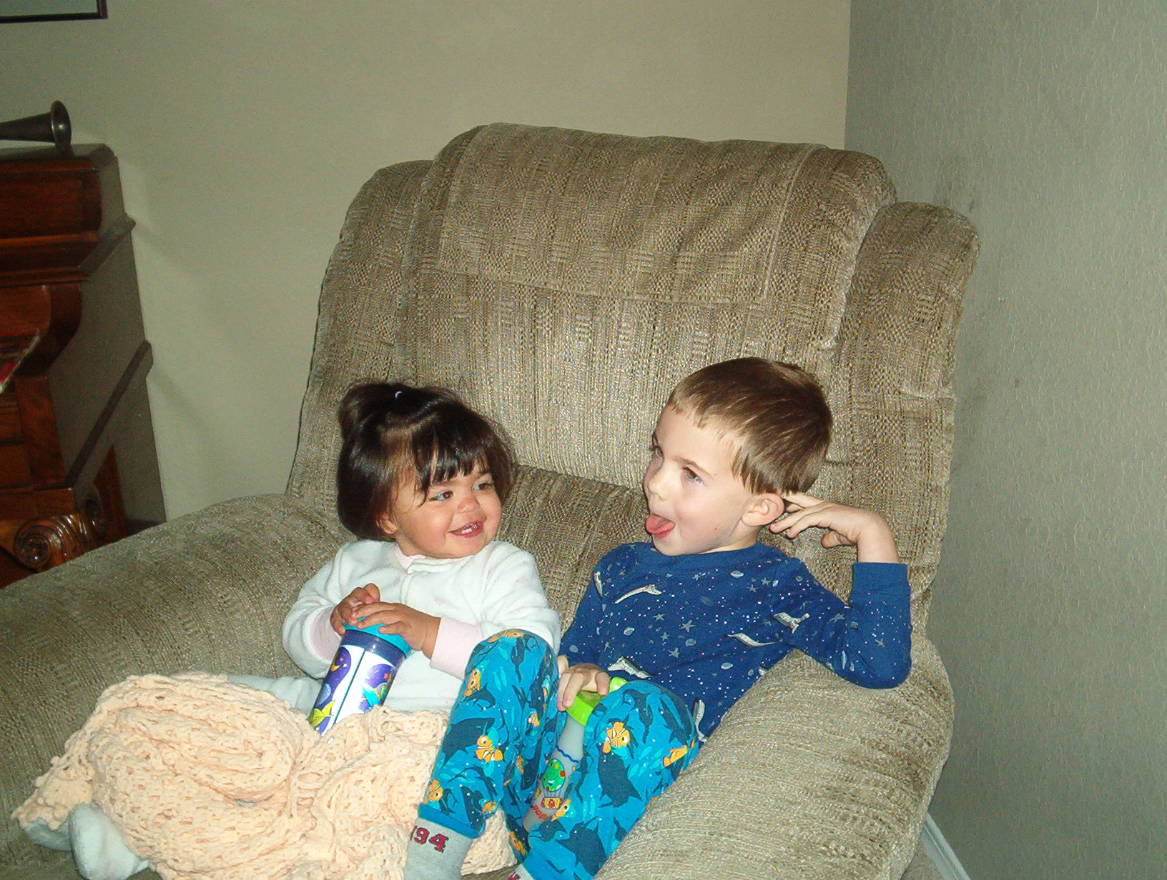
EVERYDAY ROUTINES

Slide 37
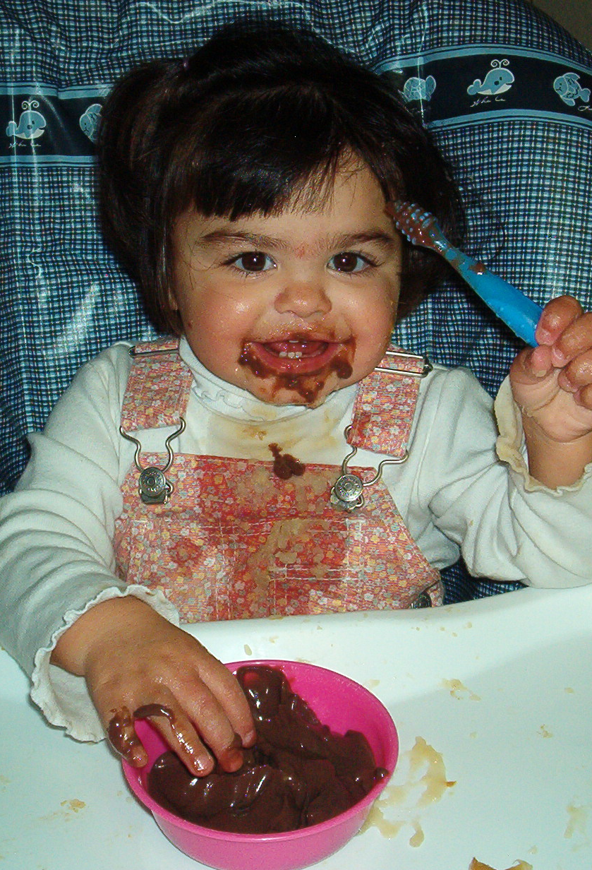
MEALTIME
Have the child in the kitchen with you!
Have the child sitting at kitchen table with the family for meals
Braille magnets on the fridge
Have the child help find and prepare food
Cabinet/drawers/shelves devoted to child
Items labeled with object/Braille/print
Muffin tin/egg carton (Braille cell);
to serve snack
Sing songs/rhymes about
preparing food
Color, shapes, sizes of food
Temperature

Slide 39
BATH TIME
Identifying body parts
Location words (“the duck is behind you”)
Bathtub crayons
“Coloring” in soap
Stick on decals (letters/shapes)
Songs
Temperature
Counting fingers and toes
Books about bath time (homemade/story bags)

Slide 40
OUTDOOR PLAY
Drawing activities in sandbox
Sidewalk chalk
Paintbrushes with water
Homemade books from nature walk
Movement (stroller, walking, push car) with location words; fast/slow; bumpy/soft (ECC-O&M)
Songs with movement (ring around the Rosie)
Playground equipment (up/down)
Listening and identifying environmental sounds

Slide 41
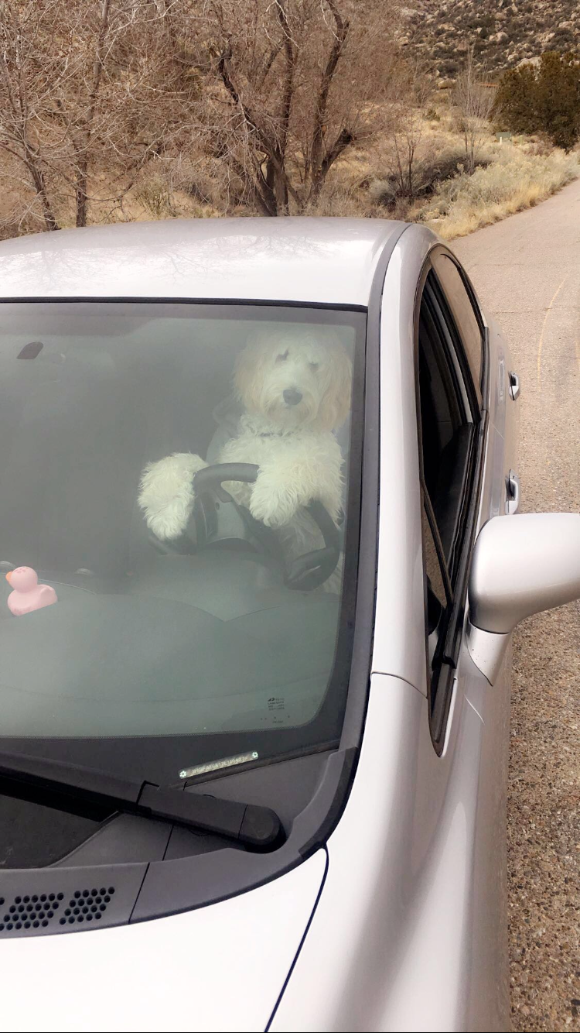
ON THE GO
Singing songs
Window markers
Window clings (shapes, letters)
Cookie sheet with magnets
On the Go Literacy bucket
Bib/shirt with links (real objects)

Slide 42
COMMUNITY PLACES
Grocery store: make a grocery “list” accessible by child; describing words for foods (hard/soft; squishy; fragrant; smooth/bumpy; same/different; big/little; heavy/light)
Library: story time; exploring bookshelves; quiet reading; make library bag
Restaurants: menu exploration (braille); identifying sounds and smells; books about eating out
Laundry Mat: temperature; identification of sounds and smells; in/out; sorting
Opportunities for discussions around careers (ECC)

Slide 43
BEDTIME
Basket of Objects (Tanni Anthony)
Nighttime story books (repetition)
Songs
Homemade story book about bedtime routine/Sequencing (helps with anticipating what will happen next)
Texture identification/vocabulary (soft blanket, plush stuffed animals, colors, warm, tired, sleepy, calm)

Slide 44
Zero to Three (2011)
“Given the importance of parent-child relationships in nurturing early development, family literacy is a key factor and influence in a child’s early literacy experiences….Additionally, when families share stories, songs, and books with their children, they not only model how their children develop literacy skills, but also give their children the message early on that learning to read and write is important.”

Slide 45
Early literacy means involving children in daily opportunities to explore their world
45

Slide 46
RESOURCES
www.adifferentkindofvision.blogspot.com
http://tipsheetsofthemonthandmore.org/
http://families.naeyc.org/article/12-thing-babies-learn-when-we-read-them
http://www.nationaldb.org/literacy
www.walearning.com
www.tsbvi.edu/Education/activities.htm
www.wonderbaby.org
Braille and Your Baby or Toddler (Hadley)
www.pathstoliteracy.org

Slide 47
YouTube references
“How to Read When You’re Blind:” Ray McCallum; TEDx Sydney
Zero to Three: A Window to the World: Promoting Early Language and Literacy Development

Slide 48
Luannestordahl@nmsbvi.k12.nm.us
505-903-8022

